Slide 1
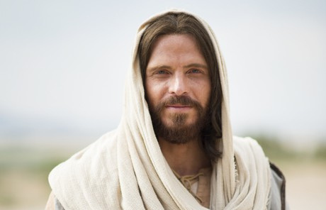
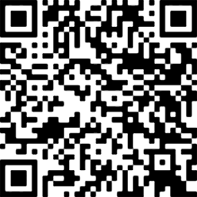
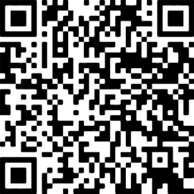


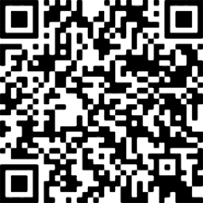
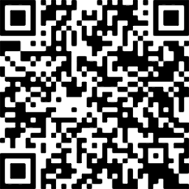
YOU MAY REGISTER FOR ANY CLASS REGARDLESS OF WHERE YOU LIVE IN FRANKLIN COUNTY Or MEMBERSHIP IN ANY RELIGION
FRANKLIN COUNTY STAKES
SELF RELIANCE OPPORTUNITIES
Self Reliance Initiative Purpose:
The purpose of becoming spiritually and temporally self-reliant is to better serve the Lord and care for others. The Savior invites us all to act, to stand independent, and to become as He is. He will help us. He has promised: “It is my purpose to provide for my saints, for all things are mine. But it must needs be done in mine own way.” His way includes learning and living the principles of self-reliance—“the ability, commitment, and effort to provide the necessities of life for self and family.”
In the initiative, much of the work takes place in small groups that combine spiritual principles with practical skills. Groups are focused on one of four areas: employment, education, personal finances, or starting and growing a business.
Register Now!!
Classes begin in September
SCAN or CLICK on the QR Code to Register!
Personal Finances (12 classes)
South Stake 55 E. 100 S.
Sunday Sep. 7 | 7:00pm
Emotional Resilience (10 classes) North Stake 155 N. 200 W.
Sunday Sep. 7 | 7:00pm
This group is for those who want better control over their finances.
Time, date, and location listed are initial classes only. Best times will be determined by the group.
This group will help you learn spiritual and practical skills to help each of us better care for our body, mind, emotions, and relationships. Time. date and location listed are initial class only. Best time for the group will be determined by the group.
https://quickreg
https://quickreg
Women’s Emotion Resilience(10 classes)
Women only
East Stake, 310 N. Main St.
Sunday Sep. 7 | 7:00pm
Starting & Growing a Business (12 classes)
5th – 8th Ward Bldg. 213 S. 200 E. (Sunday Sep. 7 | 7:00pm
This group will help you learn spiritual and practical skills to help each of us better care for our body, mind, emotions, and relationships. Time, date and location listed are initial classes only. Best time for the group will be determined by the group.
This course was developed to help you learn key business skill such as identifying customer needs, finding customers and keeping good business records..
https://quickreg
https://quickreg
For more information contact:
Preston Idaho South Stake
Val & Marilyn Jensen 208-220-6167
Preston Idaho North Stake
Calvin & Cathy Winward 208-847-5062
Preston Idaho East Stake
Trish Checketts 208-317-4782
Franklin Stake
Dennis Sessions 208-681-3788
REGISTRATION OPEN NOW
Call for help in registration or come to the class
and we will help you

