Slide 1
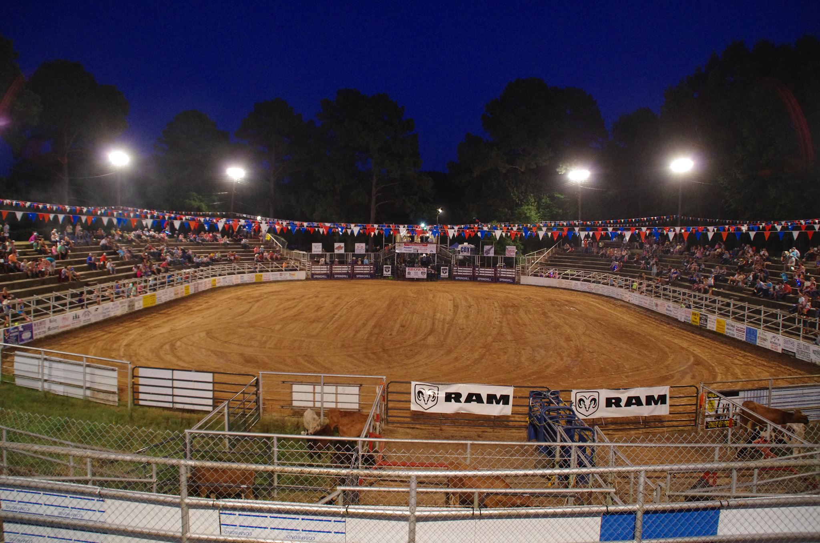
Springhill Rodeo 2026
Sponsorship Packages
September 2026
Springhillprcarodeo.com
FB-Springhill Rodeo

Slide 2
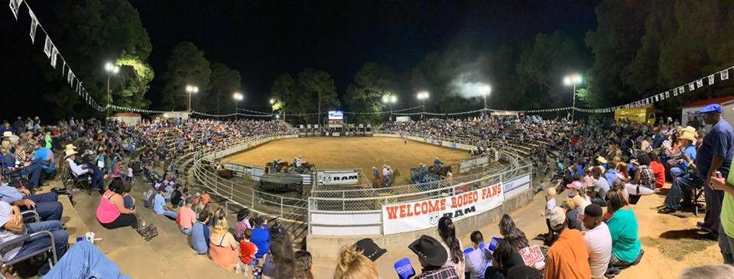
The Springhill Rodeo is a staple in the Springhill community & surround areas.
Thousands of people come every year from across our region to be a part of the festivities and see some of the top cowboys and cowgirls in the world.
With over 2,000 people following this event on social media along with over 4000 attendees in 2025, we are expecting to greatly exceed our numbers for 2026. Advertising on KTBS TV increased awareness of our rodeo in the Shreveport/Bossier area and has brought us new fans who get to experience our one of a kind arena and professional rodeo at its best.
Food, family fun & great sportsmanship are what you will expect at the 2026 Springhill Rodeo!

Slide 3
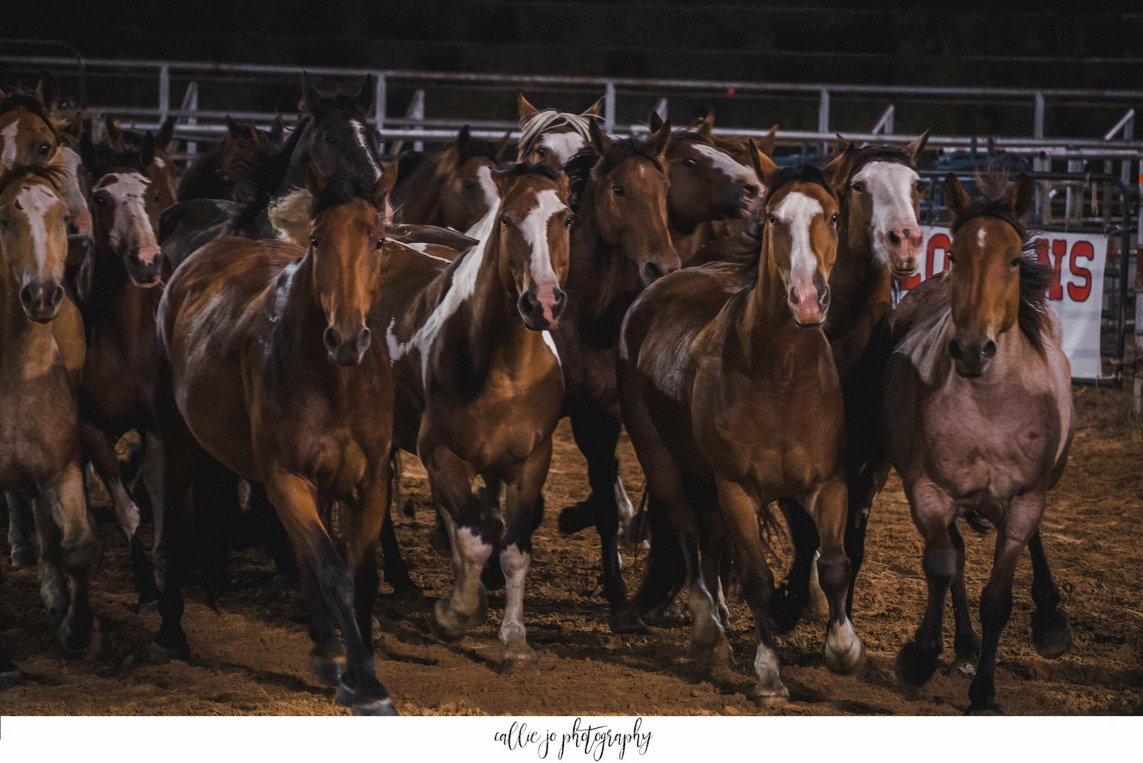
Sponsorship Levels
Title Sponsorship $10,000
Rodeo will be listed as “(Name of Title Sponsor/ Springhill PRCA Rodeo
25 Free tickets to the Rodeo
VIP Seating/ VIP Parking
Flag presence & Special recognition at the rodeo and during the Thursday Opening Day Parade
Ad on the Jumbo Tron playing throughout the Rodeo
Listed on the Springhill Rodeo Association Website and Facebook Page with logo and all sponsorship information
Sponsor name on large sign at both ends of the arena and Sponsor name on large sign located on Main St in Springhill.
Sponsor name on cover of program given out to each individual each night at the rodeo.
Platinum Sponsorship- $2,500
15 free tickets/2 VIP parking passes
Corporate name on 200 tshirts
Flag representation at the Rodeo & during the Thursday Opening Day Parade
Logo on Springhill Rodeo website and Facebook page
Logo on the Jumbo Tron playing throughout the rodeo
Sponsor name on large sign at both ends of the arena and sponsor name on large sign located on Main St in Springhill.
Listed in program given out to each individual each night at the rodeo.

Slide 4
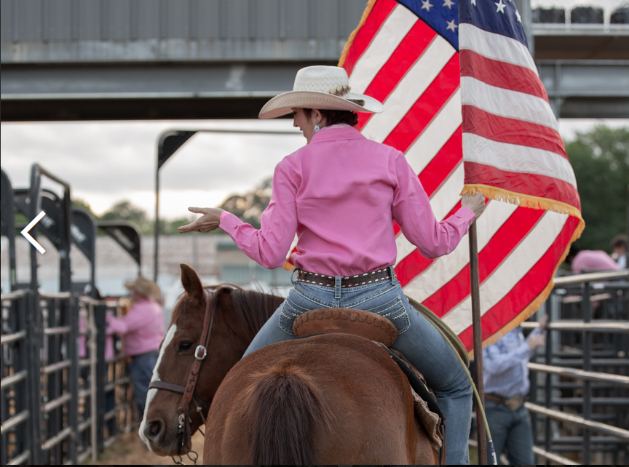
Gold - $1,000
10 Free Tickets to the rodeo
1 VIP Parking
Listed on Springhill Rodeo website
Listed on Springhill Rodeo Association Facebook Page
Sponsor name listed in program given out each night
4x4 sign placed in designated area in the arena
Silver- $500
5 Free Tickets to the rodeo
Listed on Springhill Rodeo website
Listed on Springhill Rodeo Association Facebook Page
Sponsor name listed in program given out each night
4x4 sign placed in designated area in the arena
Bronze - $250
3 Free Tickets to the rodeo
Listed on Springhill Rodeo website
Listed on Springhill Rodeo Association Facebook Page
Sponsor name listed in program given out each night
4x4 sign placed in designated area in the arena
Sign Sponsor- $200
Listed in program given out each night at the rodeo
Sign posted in arena

Slide 5
COMMERCIALS
Commercials are available on our huge Jumbotron for $750 for all 3 nights of the Rodeo.
30 second commercials that you provide on a flash drive
Will be shown before, during and after the Rodeo.
Agreement
With Springhill Rodeo Association – Mail to: P.O. Box 701 Springhill, Louisiana. 71075 or you may email to springhillrodeo@gmail.com
Commitment Level:
Title Sponsor
Platinum Sponsor
Gold Sponsor
Silver Sponsor
Bronze Sponsor
Sign Sponsor
Commercial
Event and Chute Sponsors will only be available if one of our present sponsors decline to renew.
_______________________________ _________________ ______________________________
Signature Date Name of Business

