Slide 1

Let the games begin!

Slide 2
The Result – some expectations
Predictability
Creativity

Slide 3
The Result – some expectations
Problem
Solution
Legal
AI

Slide 4





Criteria - deliverables
Work Methodology
Explanation the shows how the team has worked to reach the result
Tech Utilisation
Explanation how the technology has been leveraged to reach result
Legal Process
Explanation how legal or other methodology used to reach the result
Feasability
Explanation of possible thresholds and how to overcome them to reach the result
Value/societal benefit
Explanation of the value created and how it will benefit greater good

Slide 5
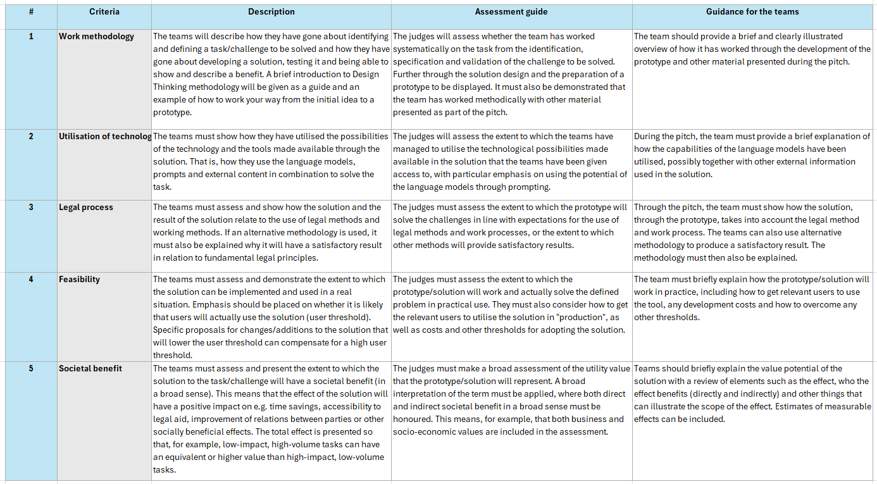

Slide 6

Methodology
Problem Space
Solution Space

Slide 7
Meet the Judges
Samson Esayas: Associate Professor at BI Norwegian Business School and a Faculty Associate at Harvard University's Berkman Klein Center for Internet and Society.
Silvija Seres: Experienced board member and chairman, with digital transformation and AI as deep expertise
Peter Lenda: Tech lawyer and partner – Advokatfirmaet Grette
Vjosa Maxhuni: Commercial Litigation Law Clerk – Oslo District Court

Slide 8

Meet the Mentors
Emil
Dan
K-M
Chanè
PWC:
Erik Shikerin
Lippestad:
Kanwal Suleman

Slide 9
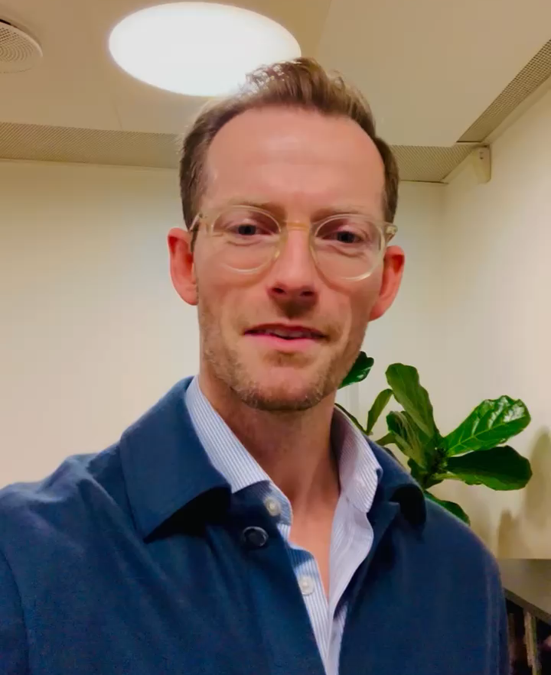
Meet the Oracle in Copenhagen
Alexander Irschenberger

Slide 10
Book time with Alex – the Oracle
15 minute slots on Saturday from 9-14. They just click the link and book. Here's a text you can use:
"Our AI oracle in Copenhagen” Alex, can be booked Saturday from 9-14 for a 15-minute slot. Just click the link and book your preferred time. First come, first served.
Booking link: https://calendar.app.google/vRxZdB9xLnfoRoZYA";

Slide 11
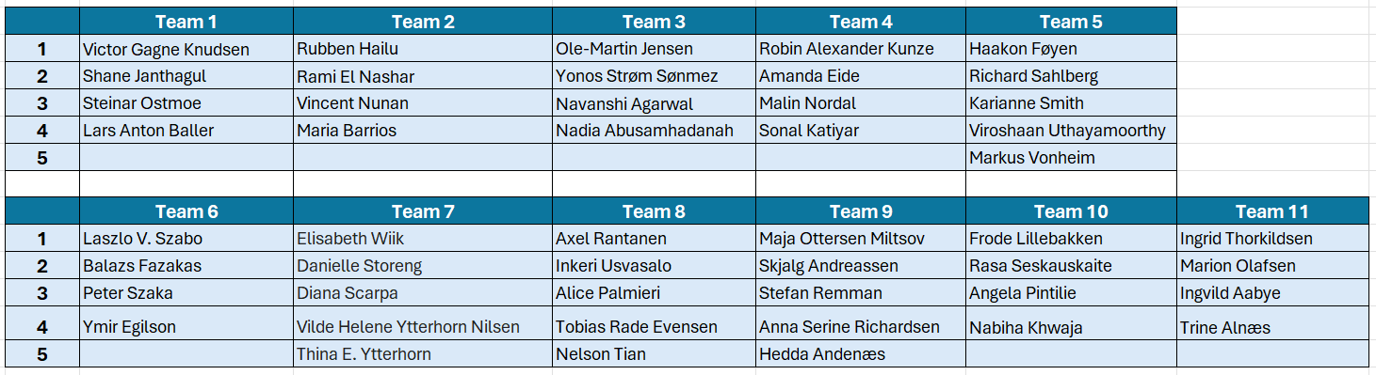

Slide 12
Let the games begin!

