Slide 1


SAU’s Title IX and Sexual Harassment and Workplace Violence Policy Update
From the Office of the
Vice President for Administration and General Counsel

Slide 2

Title IX
The Title IX Leadership Team has the responsibility to review and recommend policy related to Title IX and related legislation and rules. The Team provides:
Awareness activities
Advocacy for involved individuals
Investigation
Discipline recommendations

Slide 3

Title IX
.Title IX states that: “No person in the United States shall, on the basis of sex, be excluded from participation in, be denied the benefits of, or be subjected to discrimination under any education program or activity receiving Federal financial assistance.”
Title IX applies to institutions that receive federal financial assistance from Department of Education, including state and local educational agencies.
United States Department of Education’s Office of Civil Rights has responsibility for enforcement

Slide 4

University Responsibility for Title IX
Whether or not a complaint is filed alleging sexual misconduct, once the university knows or should know of an incident of sexual misconduct, it must take action to understand and respond appropriately. This includes all types of misconduct from assault to hostile environment.

Slide 5
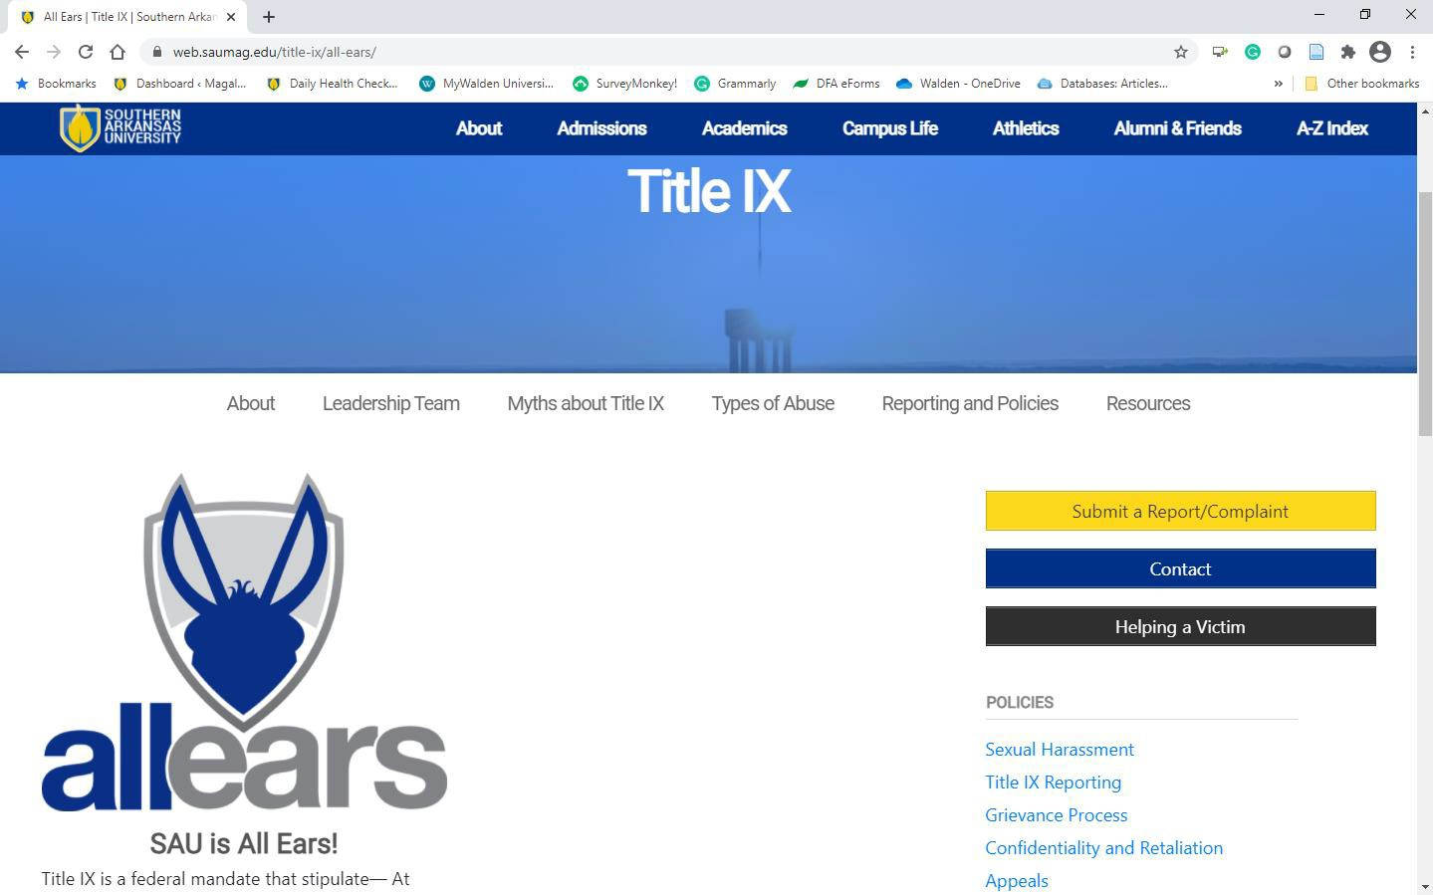
web.saumag.edu/title-ix
Reporting includes interim measures:
-Appointing advocates
-Appointing investigators
-Required notifications to parties
-Coordinating with police
-Providing training

Slide 6





Title IX Support

Slide 7

Sexual Harassment and Workplace Violence Policy
Sexual harassment violates the dignity and worth of all members of the institutional community and is unacceptable conduct which will not be tolerated.
Sexual harassment of faculty, staff, and students at SAU is defined as any unwelcome sexual advances, requests for sexual favors, or other verbal or physical conduct of a sexual nature when:

Slide 8
Sexual Harassment and Workplace Violence Policy
Submission to such conduct is made either explicitly or implicitly a term of condition of an individual’s employment.
Submission to or rejection of such conduct is used as the basis for employment decisions affecting that individual.
Such conduct has the purpose or effect of unreasonably interfering with an individual’s work performance or educational experience or creates an intimidating, hostile, or offensive work or educational environment.

Slide 9
What is Sexual Harassment?
Unwelcome sexual advances or requests for sexual favors
Other verbal or physical conduct of a sexual nature, when accepting such conduct as either explicitly or implicitly a term or condition of employment or academic decision
Have the purpose or effect of unreasonably interfering with an individual’s work or academic performance
Sexual violence and assault
May involve any member of the campus community
May involve a variety of conditions

Slide 10
Types of Sexual Harassment
Quid Pro Quo Means “this for that” Consists of an express or implied request or demand for sexual favors made by a person with authority over the employee or student in exchange for keeping or advancing in a job or receiving a certain grade or position, or some other benefit One instance is a violation
Hostile Environment When severe or pervasive conduct of a sexual nature creates a working or academic environment that is intimidating, hostile or offensive to another person
Objective standard: a reasonable person in your position would consider the conduct severe or pervasive
Subjective standard; the member of the campus community must have actually found the conduct sufficiently severe or pervasive to interfere with the work or education experience

Slide 11
Examples of Severe and/or Pervasive Harassment Conduct
Being the target of sexually-charged jokes or pranks
Touching, patting, pinching, stroking, squeezing, tickling, or brushing against a person
Being whistled at
Sexually suggestive sounds or gestures (i.e., sucking noises, winking or pelvic thrusts)
E-mails, letters, notes, telephone calls or material of a sexual nature

Slide 12

Things to Remember
Person engaging in harassing behavior is often in position of power or influence
Many stop when asked
Consensual relationships require caution, especially when a power difference exists such as supervisor/subordinate and teacher/student
Any faculty or staff member is likely perceived by a student to be in a position of authority.

Slide 13
And…
Criminal behavior (sexual assault, sexual violence, domestic/intimate partner violence) may be easily recognize.
Non-criminal, but illegal, behaviors like sexual harassment, may not be. Nonetheless, they are not to be tolerated.
Court decisions, and Department of Education interpretation of Title IX, state that when an individual has their educational experience impacted by sexual harassment, sexual assault, sexual violence, domestic/intimate partner violence, and stalking that this is a discriminatory situation and a violation of Title IX.

Slide 14
Procedure for Reporting Sexual Harassment
Any faculty or staff member may contact a vice president, dean, the president, or the Title IX Team to discuss conduct that may constitute sexual harassment.
The administrator may discuss the concerns with the individual alleged to have committed the harassment and report back to the grievant. After discussions, the person initiating the complaint has three options:
  continue with the informal grievance procedure,
  consider the matter resolved, in which case no written records will be maintained of the discussions. This part of the procedure is completely optional at the discretion of the grievant, or (3) make a referral.

Slide 15
Informal Grievance Procedure
If the complaint pertains to a faculty or staff member, the person should file the complaint in the Office of the Vice President for Administration. If the complaint pertains to a student, the person should file the complaint with the dean of students.
Upon receipt of the complaint, the Vice President for Administration will refer the complaint to the Title IX Coordinator for appropriate action.
Documentation of the mediation will include the date, names of the mediators, complaint, and the resolution. If the issue is not resolved, the person may continue with the University’s formal grievance procedure for discrimination complaints found in the University Handbook.

Slide 16

Retaliation Training
Retaliation is an act of “revenge” or “reprisal”.
Retaliation is the #1 most common complaint the EEOC receives.

Slide 17
A claim of retaliation arises when:
A student or employee engages in a protected activity
The student or employee suffers an adverse action in the educational process or employment
The student or employee suffered the adverse action because of the engagement in protected activity

Slide 18
Any conduct that is
intimidating,
threatening,
coercing, or in any way
discriminating against the individual is prohibited

Slide 19

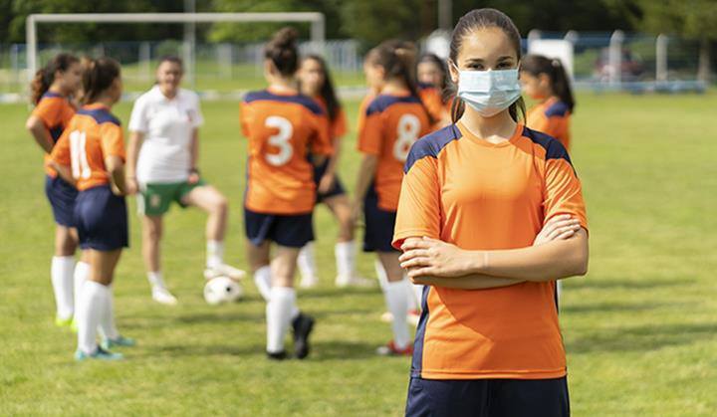
This protection applies to ALL programs at SAU, academic, athletic, and extra curricular.

Slide 20
Expansion of Coverage
Retaliation claims provide for broader coverage than the original discrimination claim. They are not limited to “terms and conditions of employment” or “standards for students” but may include “non-economic actions that would discourage an employee or student from pursuing a discrimination complaint.

Slide 21

Retaliation Training
Discriminatory practices are often only raised and remedied when students, parents, teachers, coaches, and others can report such practices to school administrators without the fear of retaliation.

Slide 22

Retaliation Training
Individuals should be commended when they raise concerns about compliance with the Federal civil rights laws, not punished for doing so.

Slide 23

Retaliation Training
When an individual makes a complaint, testifies, or participates in any manner in an investigation or proceeding relating to Title IX, they are in a protected activity and any act that is taken that would restrict or discourage that action can be considered retaliation and may be more serious than the ordinal complaint. Retaliation must be investigated just like the original complaint.

Slide 24
Violence on Campus including Sexual Assault
It is the policy to prohibit sexual assault and to prevent sex offenses committed against students, employees, visitors to the campus, and other persons who use University facilities.
Sexual assault is an extreme form of sexual harassment. Sexual harassment is prohibited by University policy and is a form of sex discrimination prohibited by Title VI of the Civil Rights Act of 1964 and by Title IX of the Education Amendments of 1972.
Sexual assault is also a crime, defined by the
Arkansas criminal code.

Slide 25
A rape is still a rape…
When consent was expressed but then withdrawn
Regardless of how the survivor was dressed
When the survivor is a man
Regardless of how much the parties involved had to drink
When the survivor knew the rapist
Even if you don’t think it would happen here
Regardless of the sexual orientation of the rapist

Slide 26
Responses to knowledge of sexual misconduct/violence:
All students are to be protected
SAU must respond to complaints and reports of sexual misconduct
Report to UPD and Counseling Center at minimum
Confidentiality should be protected to the extent permissible

Slide 27
Reporting Options for Students
Title IX Coordinator
UPD or local law enforcement
Counseling Center and University Health Services
Dean of Students
Any Title IX Leadership Team Member

Slide 28
Bystander Intervention
Everyone Can Help – Don’t Be A Bystander
Notice the event
Interpret it as a problem
Assume personal responsibility
Know how to help: NEVER put yourself in harm’s way but DO SOMETHING! Help can be direct or indirect. For instance, call the police.
Interrupt the situation
Distract. Find a way to redirect the attention of those behaving inappropriately toward something else
Initiate Help: Work with someone else
Early intervention
Effective helping
(adapted from Lehigh University’s Bystander Interventions)
Available at: https://studentaffairs.lehigh.edu/content/what-bystander-intervention

Slide 29
From the Office of the
Vice President for Administration and General Counsel

