Slide 1

Welcome Back!
New Family Meeting, 2025-2026

Slide 2
Excellence
Without
Compromise
Reverence
Respect
Responsibility

Slide 3
Train up a child in the way he should go, and when he is old, he will not depart from it.
Proverbs 22:6

Slide 4

Celebration
There is a time for everything, and a season for every activity under the heavens… a time to weep and a time to laugh, a time to mourn and a time to dance.
Ecclesiastes 3

Slide 5
FWA Website
www.faithwest.org
Home About Academics Athletics Admissions
Parent Portal Back to School Events Giving

Slide 6
Family Information
2025-2026 School Year
Welcome back, Eagles!
Important Staff to know:
Mary Strickland Principal
Vicky Gough Business Manager/HR
David Adams Athletic Director
Paula Harnisch Reimbursements/School Secretary
Kim Kruger Subs
Johnnie Clay Welcome Desk/Attendance/IDs
Cathy Sturm Admissions
Kim Derry Secondary Academic Advisor
Christian Forbes Student Advocate

Slide 7

Eagle Flyer Newsletter
Every Tuesday
If you have any information that you want to be included in the weekly newsletter email Melissa Spigener at mspigener@faithwest.org by Monday of each week.

Slide 8
Dress Code
Boy’s hair
Skirt and short length
Hoodies (Handbook p. 28)
Discipline Policy (Handbook p. 31)
Cell Phones/Smart Watches/Ear Buds
Meeting with Teachers
Teacher Hours and After-Hours Responses

Slide 9
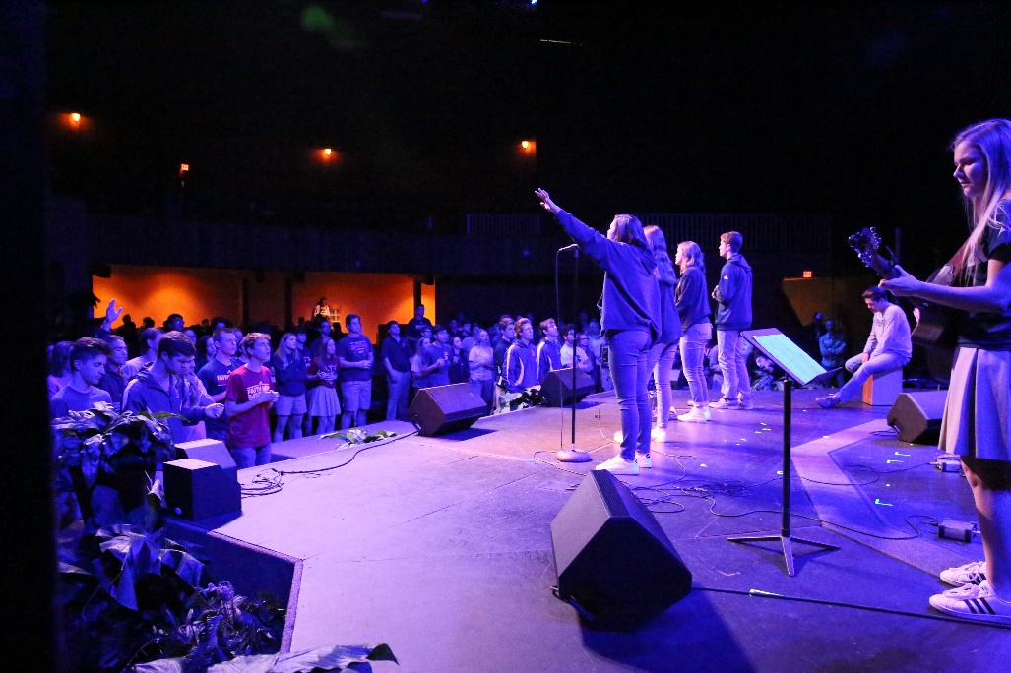
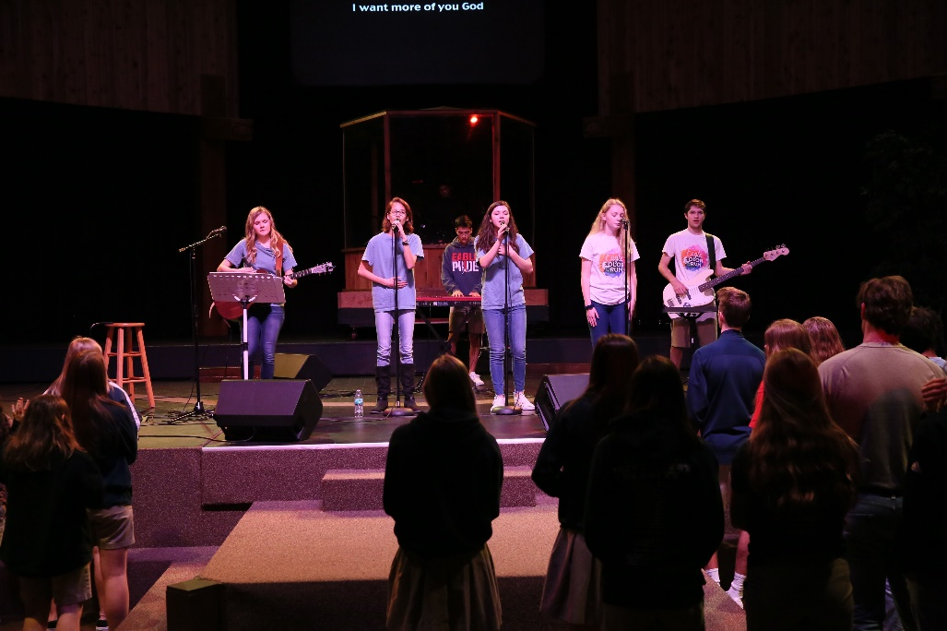
Chapel
Pre-K Chapel - Mondays at 8:30 am
Elementary Chapel - Wednesdays at 8:00 am
Secondary Chapel - Fridays at 9:00 am
Secondary Chapel Band Contact David Adams dadams@faithwest.org
Elementary Eagle Praise Team Grades 3-5: contact Noelle Perry nperry@faithwest.org

Slide 10
LUNCHES!
  www.craveitnutrition.com
  Go to Parent Portal on the FWA website, then click on Lunch Information

Slide 11

Student Drop-off
Elementary: The carpool line opens at 7:15 am. Students dropped off between 7:15 and 7:35 will report directly to the Auditorium. At 7:35, students are dismissed to their classes. Students dropped off after 7:35 will report directly to class.
Secondary: The carpool line opens at 7:15 am. Students dropped off between 7:15 and 7:35 will report directly to the Gym. At 7:35, students are dismissed to their classes. Students dropped off after 7:35 will report directly to class.
Students may not be dropped off at the front or in the parking lots.

Slide 12
Elementary Tardy Policy
The bell rings at 7:45 am. Any student entering the class after 7:45 am will be sent to the Welcome Desk for a tardy slip. Morning work begins by 7:45 each morning.
After 5 tardies, students will receive a written infraction. 8 tardies will result in a lunch detention, and each tardy after 8 will be another detention. Tardies will be logged on your child’s daily behavior chart. Parents will be notified if excessive tardies become an issue.

Slide 13
Secondary Tardy Policy
The bell rings at 7:45 am. Any student entering the class after 7:45 am will be sent to the Welcome Desk for a tardy slip.
Each tardy will result in an infraction. After the 6th infraction for tardy, the student will be issued a detention. A detention will be issued for each subsequent tardy as well.

Slide 14
Afternoon Pick Up
Carpool begins at 3:15 pm. After the first couple weeks of school, carpool is complete by 3:35 pm. Any student not picked up by 3:35 pm will be escorted to our Extended Care program. The first drop-in is free, but every drop-in after that is $15 and payment of the Extended Care registration fee.
Parents may not come in to pick up their children to avoid the carpool line. Prior notice should be given if early pick up is needed.
If you need pick your child up during the day, we ask that you contact Johnnie Clay at the Welcome Desk. When you arrive at the school for early pick-up, check in with the Welcome Desk and Ms. Clay will call for your child.

Slide 15
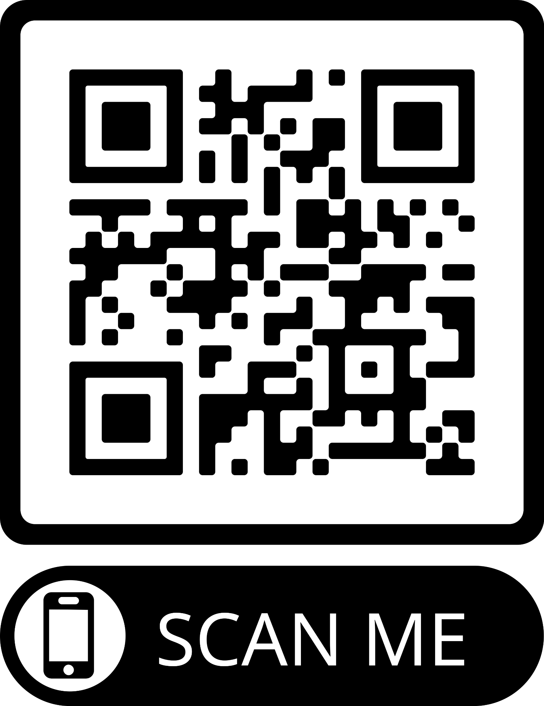

Upcoming Events

