Slide 1


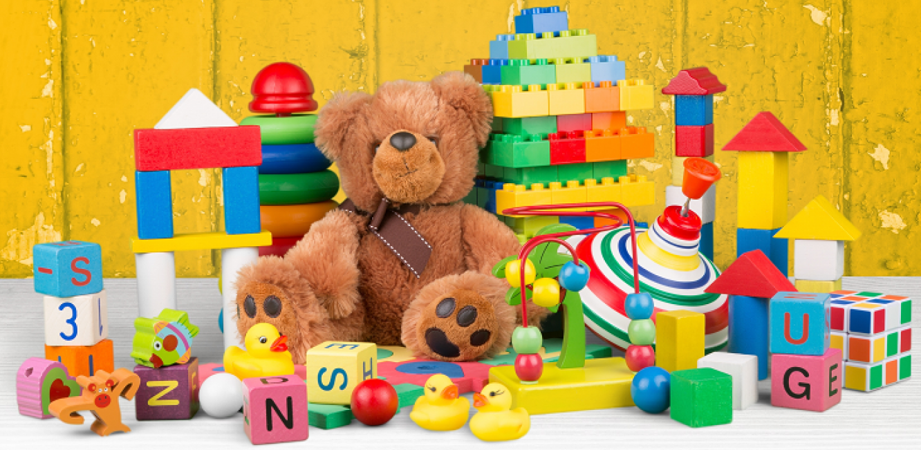

Our Learning Journey
Toys Old and New
Y1 - Autumn Term 2025

Slide 2





Literacy
Genres will include:
Lost Toy Poster – The Old Toy Room
Diary Writing - Toy Story
Character profile – Traction Man by Mini Grey
Recount - linked to Class Trip/Additional Learning Experience
Poems – Harvest
We will explore a range of high quality texts linked to our topic and use them as a stimulus for writing.

Slide 3
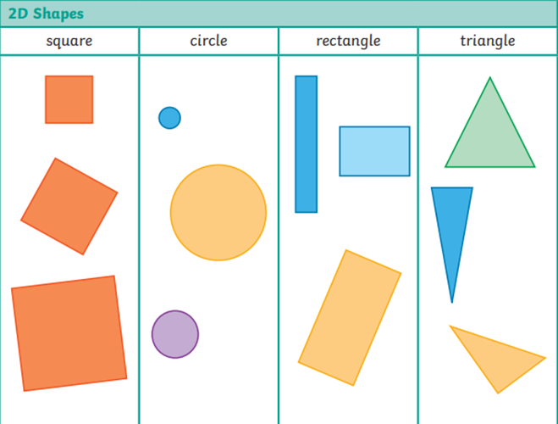
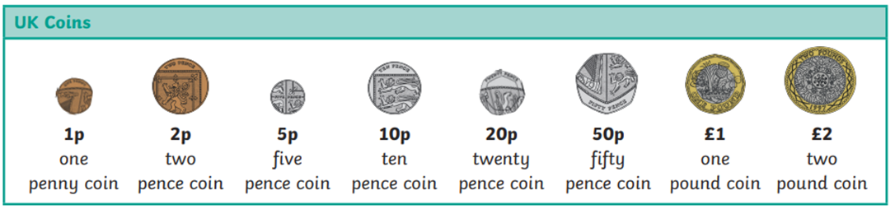

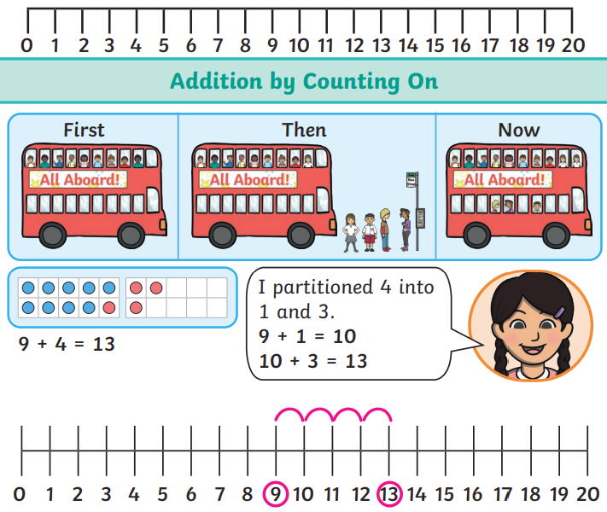
Maths
We are learning:
How to use number stories, for addition / subtraction facts, doubles and counting on/back 1.
About 2D shapes: identifying, naming and sorting according to different properties.
How to read, write, compare and order numbers to 20 and beyond; adding/subtracting 1 or 10.
How to use number facts; representing addition and subtraction with concrete objects.
About position and direction, comparing and measuring lengths with uniform units.
How to count on or back 1/2/3 and recognising coins, then finding totals.

Slide 4


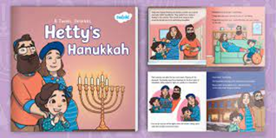

RE
Our big questions are:
Unit 1: Why do Jewish families talk about repentance at New Year?
Unit 2: Why is light important to religions?
Covering - festivals of light including Christmas and Diwali + Hanukkah

Slide 5
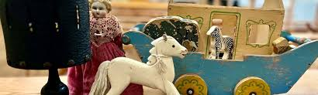
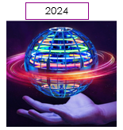
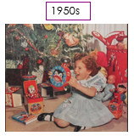
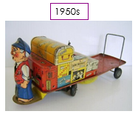
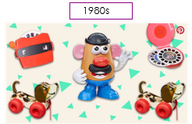

History
We are learning to:
Place events and artefacts in order on a time line.
Label time lines with words or phrases such as: past, present, older and newer.
Use artefacts, pictures, stories, online sources and databases to find out about the past.

Slide 6


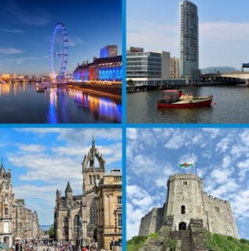


Geography
We are learning to:
Name, locate and identify characteristics of the four countries and capital cities of the United Kingdom and its surrounding seas.

Slide 7



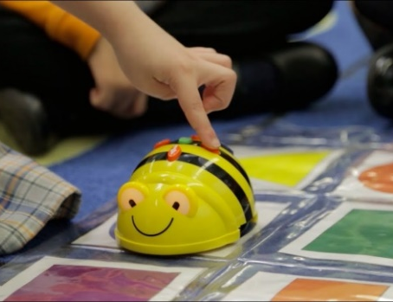
Computing
TERM 1: Information Technology Around Us
We are learning to:
Use technology purposefully to create, organise, store, manipulate, and retrieve digital content.
Recognise common uses of information technology beyond school.
Use technology safely and respectfully, keeping personal information private; identify where to go for help and support when they have concerns about content or contact on the internet or other online technologies.
TERM 2: Robot Algorithms
We are learning to:
Understand what algorithms are, how they are implemented as programs on digital devices, and that programs execute by following precise and unambiguous instructions.
Create and debug simple programs.
Use logical reasoning to predict the behaviour of simple programs.

Slide 8
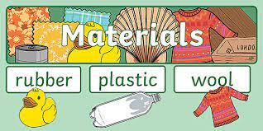

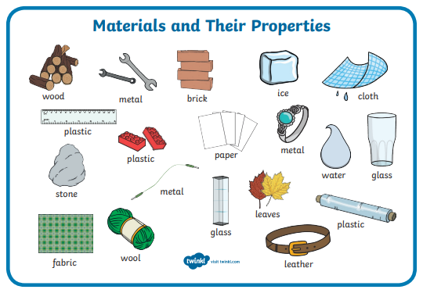
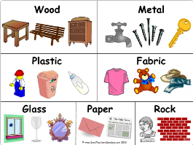
Science – Materials
Everyday Materials
Distinguish between an object and the material from which it is made
Identify and name a variety of everyday materials, including wood, plastic, glass, metal, water, and rock
Describe the simple physical properties of a variety of everyday materials
Compare and group together a variety of everyday materials on the basis of their simple physical properties.

Slide 9
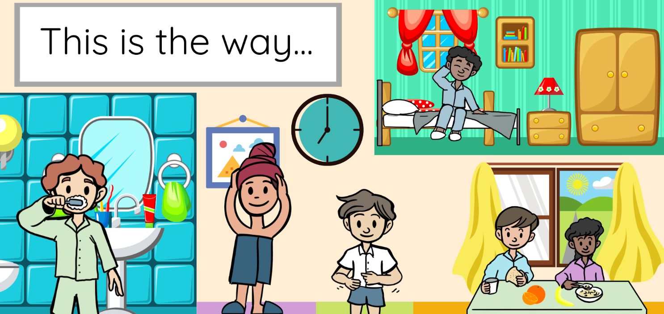
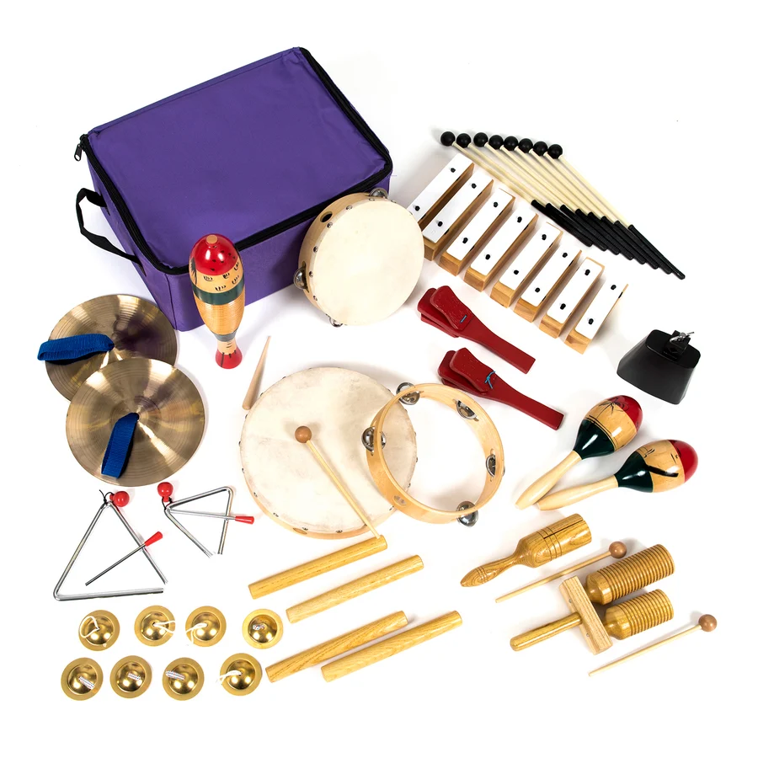
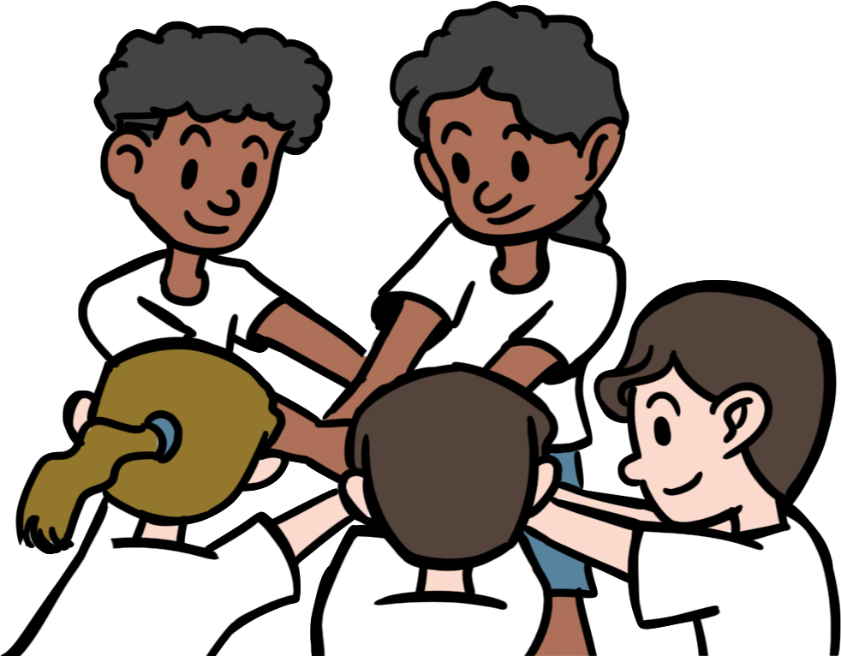
Music – Everyday Life
We are learning to:
Explore simple rhythm patterns and complete actions in time with words.
Anticipate changes in the music we sing, listening to and moving appropriately.
Sing with others, exploring rhythm.
Create our own rhythms using an instrument.
Create a sequence of body and found sounds.
Add appropriate sound effects to enhance a song.

Slide 10




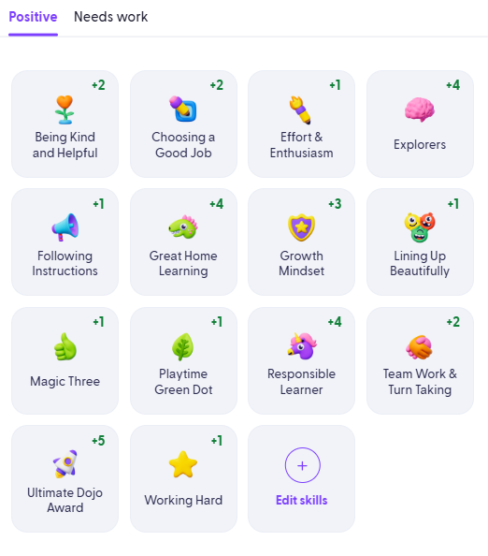

PSHE
TERM 1: Being Me In My World
Special and safe.
My class.
Rights and responsibilities.
Rewards and feeling proud.
Consequences.
Owning our learning
charter.
TERM 2: Celebrating Difference
The same as.
Different from.
What is “Bullying?
What do I do about bullying?
Making new friends.
Celebrating difference, celebrating me.

Slide 11



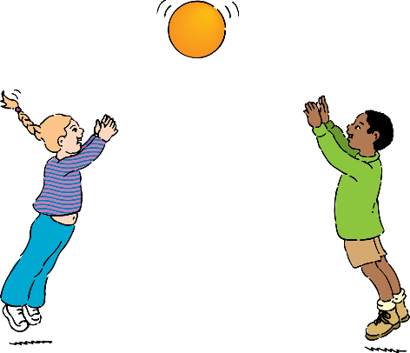
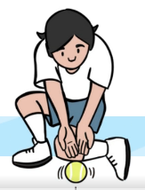
PE
We are developing our movement and coordination skills through:
Multi-skills, including throwing, catching and team-work.
Gymnastics, including work on balance, coordination and control.

Slide 12
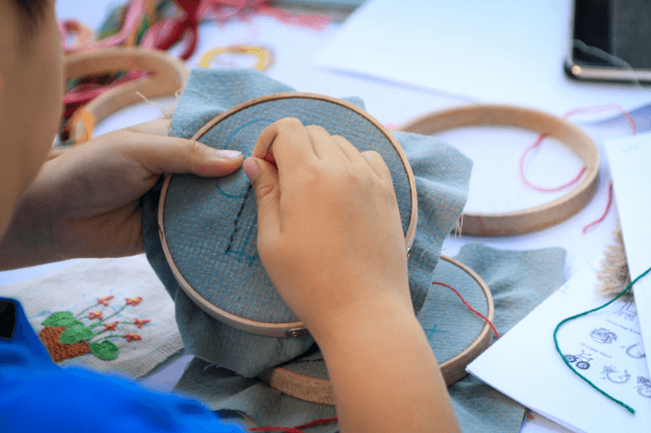
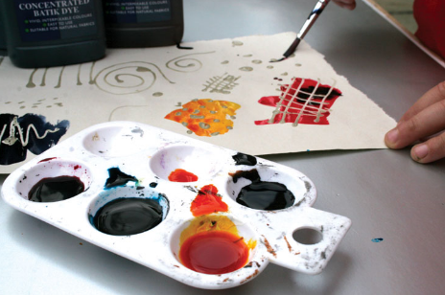
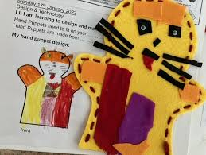
DT– Textiles
We are learning to:
• Understand how to shape textiles using templates.
• Understand how to join textiles using running stitch.
• Understand how to colour and decorate textiles using a number of techniques (such as dyeing, adding sequins or printing).

