Slide 1


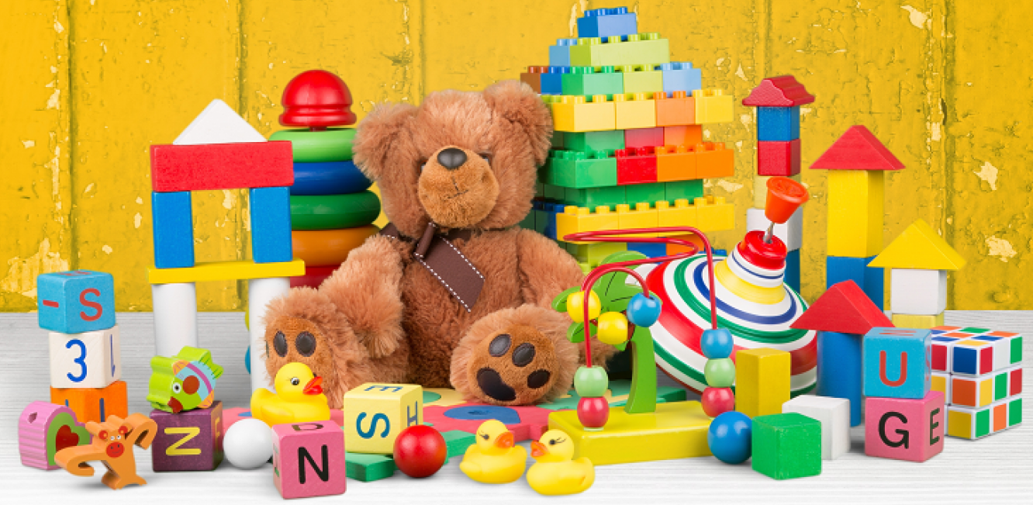

Our Learning Journey
Toys Old and New
Autumn Term 2025

Slide 2





Literacy
Genres will include:
Lost Toy Poster – The Old Toy Room
Diary Writing - Toy Story
Character profile – Traction Man by Mini Grey
Recount - linked to Class Trip/Additional Learning Experience
Poems – Harvest
We will explore a range of high quality texts linked to our topic and use them as a stimulus for writing.

Slide 3
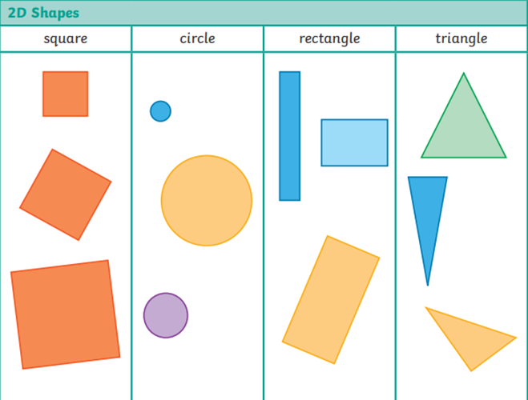
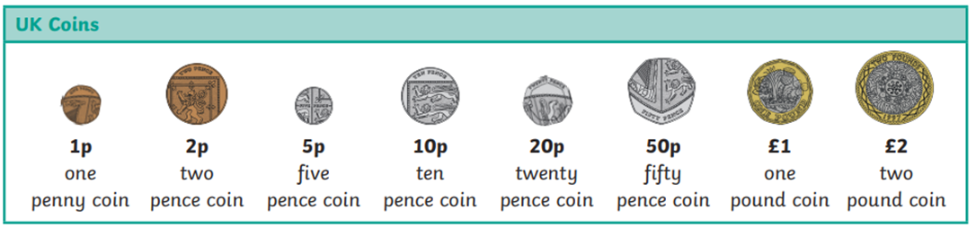
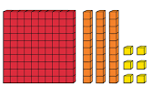


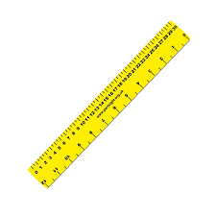
Maths
Year 1 are learning to:
Count, compare, estimate and order numbers to 20 and beyond.
Know, add and subtract bonds to 10.
Identify, sort and describe 2D and 3D shapes including circles, squares, rectangles and triangles.
Count on and back in 1’s , 10’s and 2’s.
Recognise coins and know values up to £2, and make amounts.
Compare and measure length, beginning to use standard units.
Year 2 are learning to:
Estimate and count confidently to 100.
Use number bonds to 10 to find bonds for 20 & 100.
Find doubles of numbers and halve numbers to 30.
Identify and classify 2D and 3D shapes using properties Such as right angles and symmetry.
Find 10 more and 10 less for 2 digit numbers.
Solve addition and subtraction problems using concrete and pictorial representations
Start to measure in cm’s and m’s.

Slide 4


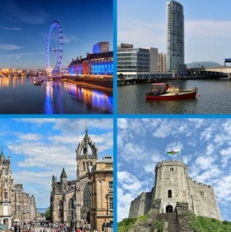


Geography
We are learning to:
Name, locate and identify characteristics of the four countries and capital cities of the United Kingdom and its surrounding seas.

Slide 5
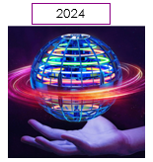
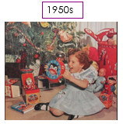
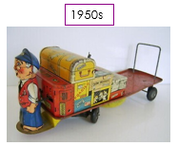
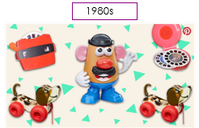

History
TERM 1: Toys
We are learning to:
Place events and artefacts in order on a time line.
Label time lines with words or phrases such as: past, present, older and newer.
Use artefacts, pictures, stories, online sources and databases to find out about the past.

Slide 6
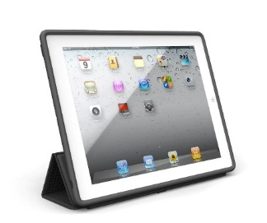


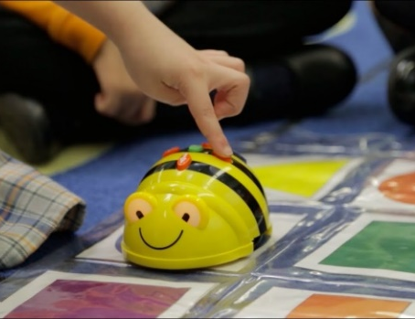

Computing
TERM 1: Information Technology Around Us
We are learning to:
Use technology purposefully to create, organise, store, manipulate, and retrieve digital content.
Recognise common uses of information technology beyond school.
Use technology safely and respectfully, keeping personal information private; identify where to go for help and support when they have concerns about content or contact on the internet or other online technologies.
TERM 2: Robot Algorithms
We are learning to:
Understand what algorithms are, how they are implemented as programs on digital devices, and that programs execute by following precise and unambiguous instructions.
Create and debug simple programs.
Use logical reasoning to predict the behaviour of simple programs.

Slide 7




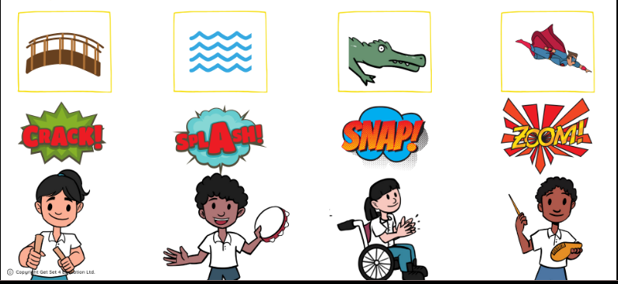

Music – Superheroes
We are learning to:
Explore the concept of soundscapes, graphic score and the inter-related dimensions of pitch, dynamics, duration, timbre and tempo.
Identify pulse, instruments and changes in dynamics.
Use dynamics, tempo & structure and explore sound.
Perform a group ensemble, adding actions, following a score, conductor and changes in dynamics when singing.

Slide 8

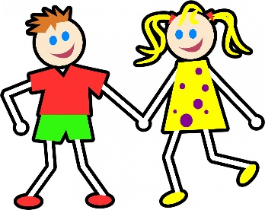
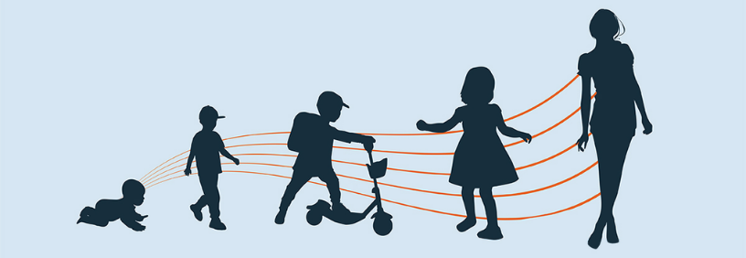
PSHE
TERM 1: Being Me In My World
YEAR 1
Special and safe.
My class.
Rights and responsibilities.
Rewards and feeling proud.
Consequences.
Owning our learning charter.
YEAR 2
Hopes and fears.
Rights and responsibilities.
Rewards and consequences.
Our learning charter.
Owning our learning charter.
TERM 2: Celebrating Difference
YEAR 1
The same as.
Different from.
What is “Bullying?
What do I do about bullying?
Making new friends.
Celebrating difference, celebrating me.
YEAR 2
Boys and girls.
Why does bullying happen?
Standing up for myself and others.
Gender diversity.
Celebrating difference and still being friends.

Slide 9
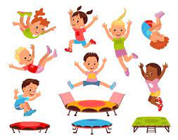

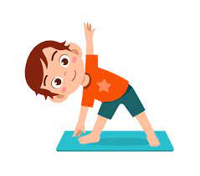
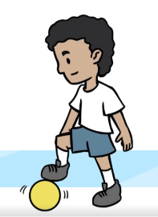

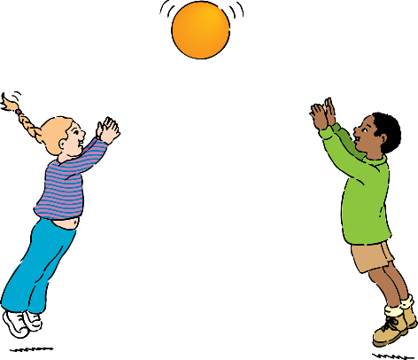
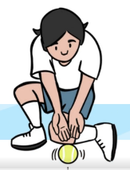
PE
We are developing our movement and coordination skills through:
Multi-skills, including throwing, catching and team-work.
Gymnastics, including work on balance, coordination and control.

Slide 10
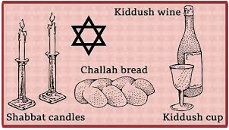
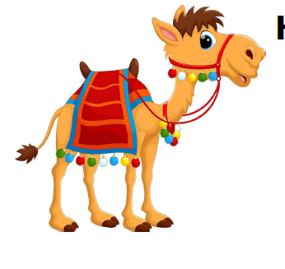



RE
Our big questions are:
TERM 1: Why do Jewish families say so many prayers and blessings?
TERM 2: How do some Muslims show Allah is compassionate and merciful?

Slide 11
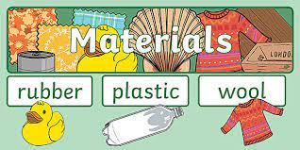

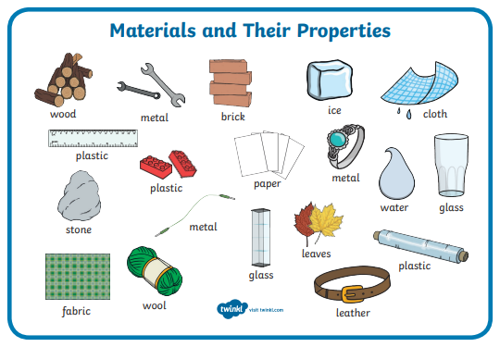
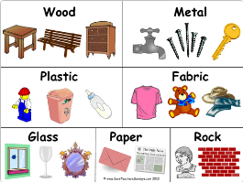
Science – Materials
Year 1: Everyday Materials
Distinguish between an object and the material from which it is made
Identify and name a variety of everyday materials, including wood, plastic, glass, metal, water, and rock
Describe the simple physical properties of a variety of everyday materials
Compare and group together a variety of everyday materials on the basis of their simple physical properties.
Year 2: Uses of Everyday Materials
Identify and compare the suitability of a variety of everyday materials, including wood, metal, plastic, glass, brick, rock, paper and cardboard for particular uses.
Find out how the shapes of solid objects made from some materials can be changed by squashing, bending, twisting and stretching.

Slide 12
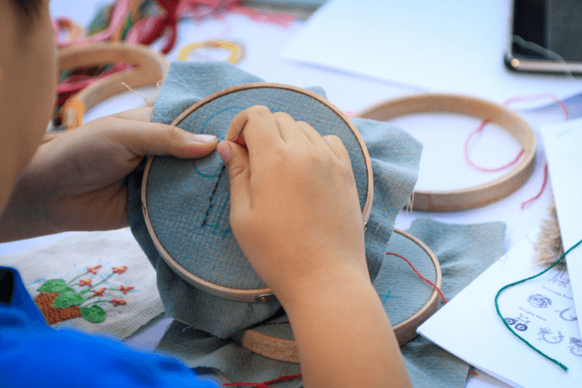
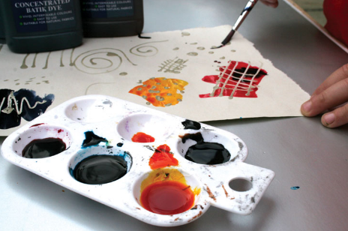
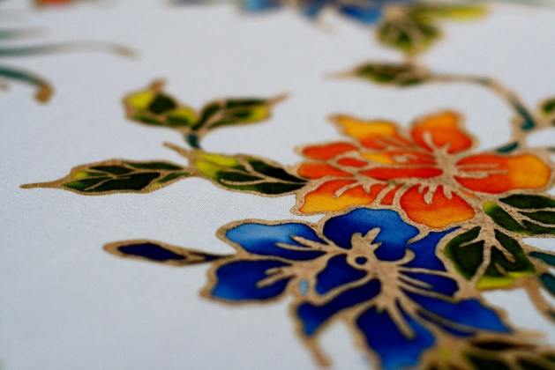
DT– Textiles
We are learning to:
• Understand how to shape textiles using templates.
• Understand how to join textiles using running stitch.
• Understand how to colour and decorate textiles using a number of techniques (such as dyeing, adding sequins or printing).

