Slide 1
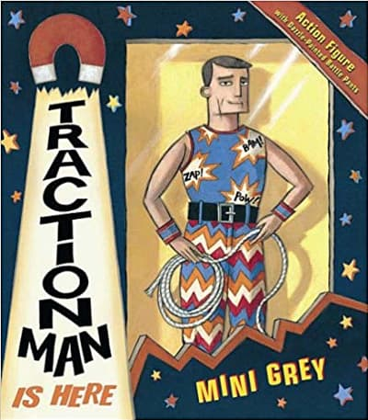
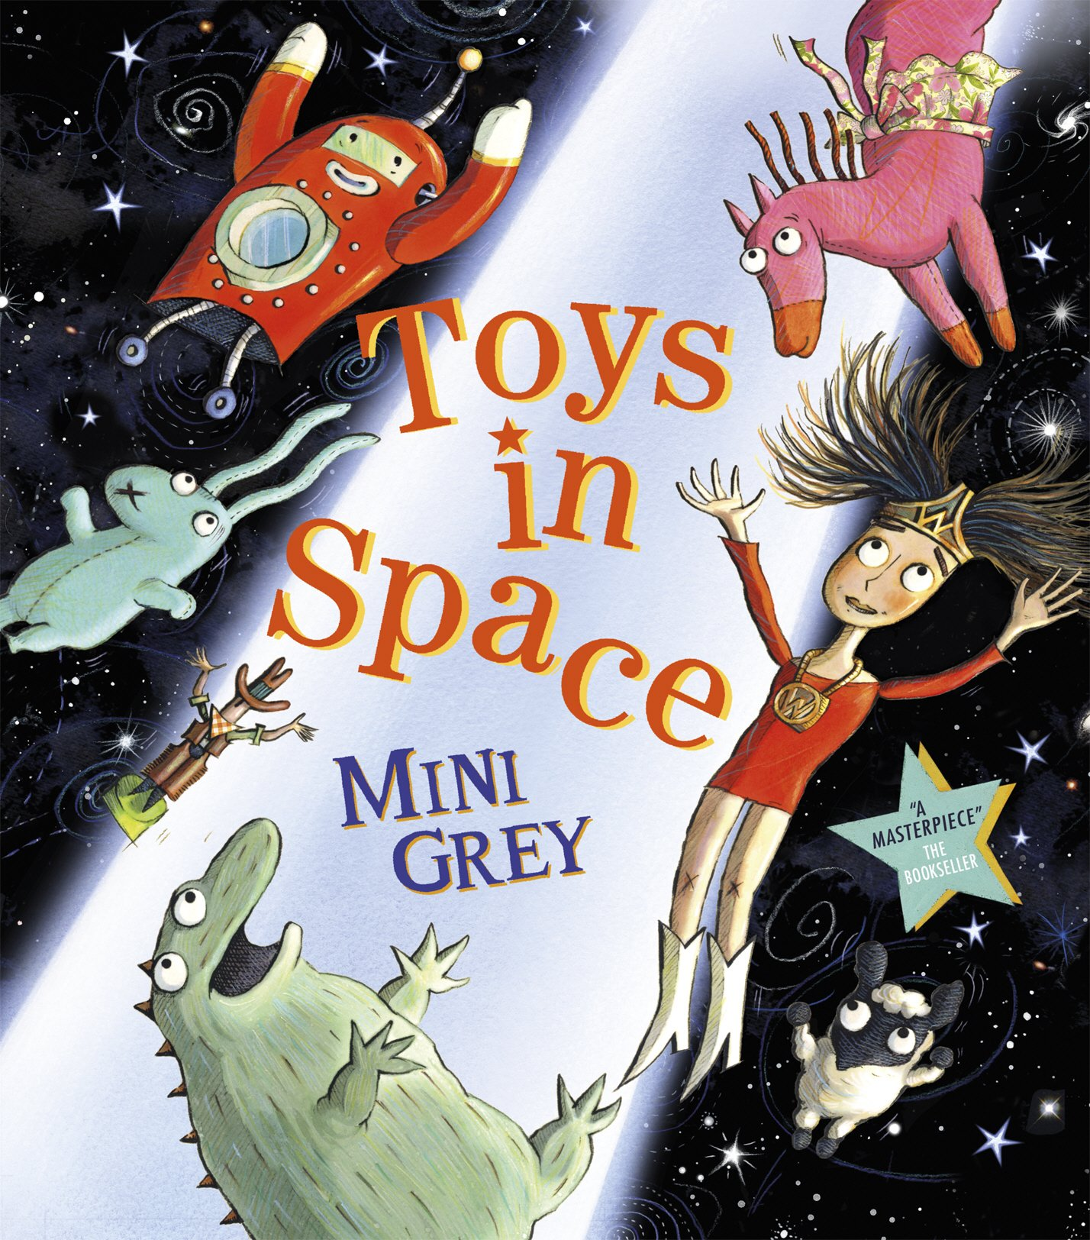
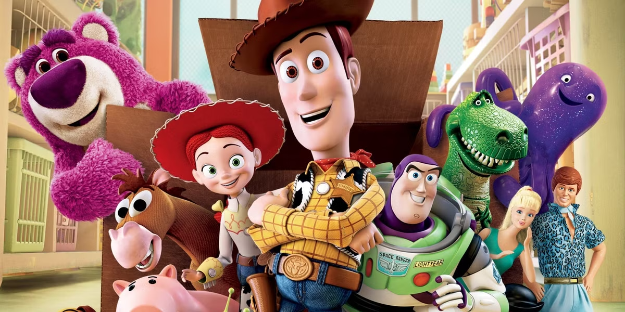
Old and New Toys – YR Autumn Term Curriculum Overview 2025
Rationale: through this fun and accessible topic children will be able to share their own experiences of familiar toys and find out about toys that their peers enjoy playing with. Children will also be learning about toys from the past, and comparing old and new toys. We will encourage children to become confident at choosing and using a range of toys and resources independently. Children will also contribute art work to displays and develop their literacy and numeracy skills using toys as a focus for phonics, writing and number work.
Additional Experiences: Green Fairy trip to Wakehurst
Opportunities to develop knowledge and understanding of the wider world & diversity:
Some of our topic work will focus on learning about Toys from around the world.
The children will learn about and take part in our annual Harvest festival as well as commemorate Remembrance Day through a service in school.
Through weekly PSHE sessions using the Jigsaw resources.
Literacy: Key Texts: Traction Man, Toys in Space, Paper Dolls & The Naughty Bus. This term the children will use quality key texts linking to our topic throughout their literacy learning. They will begin to, through daily phonics, learn to recognise, read & write letters and common words, developing correct letter formation, pencil control & grip.
Physical Development: Children will develop fine & gross motor skills, using cutting and joining materials and building models using construction. They will develop control, coordination & confidence through gymnastics and dance sessions as well as ‘write dance’ and ‘doh disco’ which supports their writing skills.
Maths: counting to 10 and then 20, counting items into sets and matching the correct numeral. Count using 1:1 correspondence. Copy and continue repeating patterns using colours, shapes objects, sounds and actions. Subitise numbers to 6, name and order the days of the week and use language related to time. Use positional language to describe where things are and begin to recognise that addition and subtraction are the inverse of each other.
Understanding the World:
Exploration & investigation: (Ecology focus) We will be looking closely at things in nature, e.g. animals and plants, and talking about what we have seen, as well as talking about how being outside makes us feel. We will learn that plants and animals need water and animals need food and begin to learn that we need to take care of our materials, e.g. putting things away properly.
Time/History: exploring the history of toys, comparing old and new.
Place/Geography: looking at different toys from around the world and beginning to learn the countries of the UK and their capital cities. Computing: Online safety and using the internet respectfully; using programmable toys. Opportunities to interact with DoodleMaths.
RE Key Questions and Concepts: Why do Jewish families talk about repentance at New Year? & Why is light important to religions? Covering - festivals of light including Christmas and Diwali + Hanukkah
Communication & Language: Listen with concentration to a range of stories & poems, joining in where appropriate. Children will contribute to displays and role-play areas by making signs, labels, pictures and models. Develop listening & speaking skills through activities with a talk partner and in small and large groups.
Personal, Social and Emotional Development/PSHE:
We will begin our term by focusing on big changes and settling into school. We will create our class Golden Rules together discussing roles and responsibilities in the classroom.
Using the Jigsaw PSHE scheme we will also explore these themes:
Being Me In My World.
Celebrating Differences.
Expressive Arts & Design:
Design & Technology: Children will explore a range of textiles and design and make a felt hand puppet. They will do observational paintings and drawings of favourite toys using a range of colours, resources and tools.
Music: In this unit children will focus on everyday life and routines and adventures we might have at home and out and about. They will sing a range of songs exploring pitch, dynamics and tempo. Children will create their own songs, add actions moving to a steady beat and add sound effects. Children will also take a role in our Nativity performances nearer Christmas.
Home Learning: YR children will have their reading diaries checked and books or ditty sheets will be sent home on Fridays. They will be entered into the half termly reading raffle for reading three times a week and will receive four ‘reading reward’ dojos for reading four times in the week. Doodle Maths is set every Thursday linking to the maths theme that week.
Role Play Area: Toy Shop & Santa’s Workshop nearer Christmas

