Slide 1



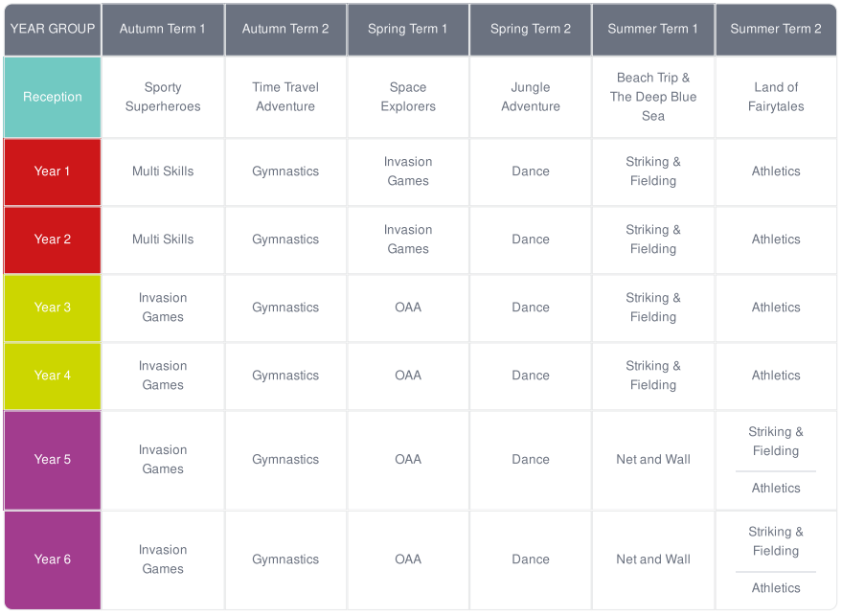
Farcet C of E Primary School
PE – Long Term Plan
At Farcet C of E Primary School we teach mixed age classes from Year One to Year Six. Our classes are structured into four classes: Reception EYFS, Year One/Two, Year Three/Four and Year Five/Six.
To ensure complete and thorough coverage of our curriculum, we follow a two-year teaching cycle comprising of Cycle A and Cycle B. Cycle A is comprised of Year 1, 3 and 5 objectives and cycle B is Year 2, 4, and 6 objectives. Reception EYFS follow a single year curriculum that is completed each year.

