Slide 1
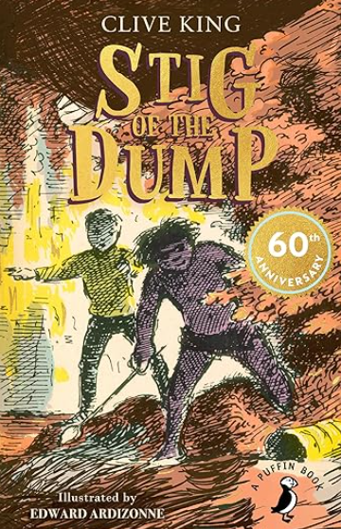


ENGLISH: Stig of the Dump
by Clive King
Reading:
Language Devices: similes, short sentences, italics, expressive language, metaphor, oxymoron, ellipsis.
Identify how authors express time place or cause.
Use adverbs to express time, pace or cause.
Writing:
Write to inform through a biography on Clive King
Write to entertain through a short narrative with 3rd person, including character and setting description and speech.
Write to entertain through a short narrative based on Chapter 7.
Farcet C. of E. Primary School Curriculum Overview:
Autumn 1 2025
Year Group: 3 and 4 – Luther King Class
SCIENCE: The Human Body
MATHS:
We will learn:
To be able to describe one of the many systems in our body.
To know our body contains different systems that enable us to grow, move and respond to the world around us.
To know our digestive system breaks down food into energy and nutrients.
To know the brain sends messages around our bodies through our nervous system
To know the skeletal system support and protects our bodies
To know the muscular system enables us to move our bodies
Working Scientifically:
• reporting on findings from enquiries – including oral and written explanations.
To use displays or presentations to show straightforward scientific evidence.
Year 3: - Place Value
Represent, partition, place on a number line 0-100
Count in 100s to 1,000.
Represent, partition, compare, order numbers to 1000.
Find 1, 10 or 100 more or less to 1000.
Count up in 50s.
Apply number bonds.
Add and subtract 1s, 10s and 100s
Year 4: - Place Value
Represent, partition, place on a number line 0 – 1000.
Represent, partition, place on a number to 10,000.
Find 1, 10, 100, 1000 more or less than a number to 10,000.
Estimate on a number line, compare, order numbers to 10,000.
Roman Numerals to 100.
Round to the nearest 10, 100, 1000.
Add and subtract 1s, 10s, 100s and 1000s.
Add up to two 4 digit numbers without and with exchange.
Subtract up to two 4 digit numbers without and with exchange.
COMPUTING:
Computing and Computer Systems: The Internet
What is a website?
Who owns a website?
Can I trust everything I read?
GEOGRAPHY: Spatial Awareness
We will learn to:
Understand maps, compasses (to eight points) and symbols.
Understand four and six fugure grid references.
Understand map scales
Contrast Peterborough with San Francisco (Human & Physical Geography)
RE: What is my duty and how do I know? Part 1
We will learn:
Sikhs follow Sikhi and believe in Waheguru (satguru)
Sikhs aspire to become gurmukh (God-centred)
The teachings of the gurus, including the Guru Granth Sahib, help Sikhs achieve gurmukh
Sikhs can fuilfil their duty through treating everyone as equal and performing sewa
Sikhs can fulfil their duty in a variety of ways; this will be affected by context
LATIN: Minimus
Children will be introduced to Minimus and a family in Vindolanda. Children will learn about life during this time and the associated Latin.
ART: Line
We will learn to:
to understand that artists use sketchbooks and that lines are basic tools for artists.
To understand that artists can use different line weight.
To understand that artists can use lines in different ways.
To understand that printing can create lines.
HISTORY: Stone Age to Iron Age
MUSIC: Off Beat
To be able to sing and play musically with increasing confidence and control
To be able to develop an understanding of musical composition, organising and manipulating ideas within musical structures and reproducing sounds from aural memory
To be able to play and perform in solo and ensemble contexts, using their voices and playing musical instruments with increasing accuracy, fluency, control and expression
To be able to listen with attention to detail and recall sounds with increasing aural memory use and understand staff and other musical notations
To appreciate and understand a wide range of high-quality live and recorded music drawn from different traditions and from great composers and musicians.
We will learn to know:
that the Stone Age is divided into three sections: The Palaeo-lithic, Mesolithic and Neolithic
during the Mesolithic/Middle Stone Age, people in Britain were hunter-gatherers and were usually nomadic
farming began in the New Stone Age/Neolithic
the Bronze Age began when people learned how to make objects from Bronze
Stonehenge is a prehistoric monument built over 5000 years ago
the Iron Age began around 800 BCE when people
PSHE: Cambridgeshire Syllabus
Citizenship - Rights, rules and responsibilities

