Slide 1


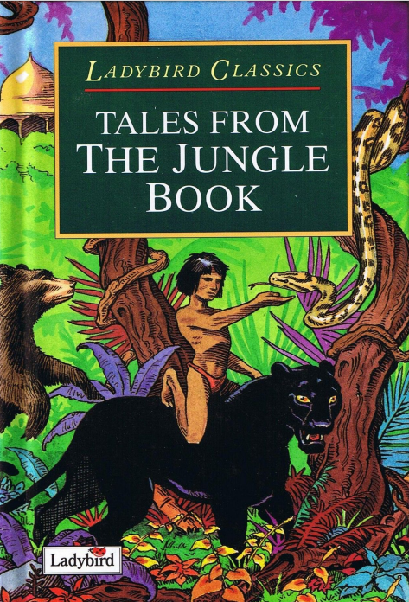
ENGLISH
Class Text: Tales From The Jungle Book
(Ladybird Classics – Rudyard Kipling)
We will learn to:
Identify and write compound sentences using and / but / or / so
Identify complex sentences using because / if / when
Maintain a consistent tense.
Write simple, compound and complex sentences
Write speech by a single character
Synonyms/antonyms: big, small, hot, cold, happy, sad, scared, said, move
Identify and use adjectives to describe nouns
Identify plot points in a story
Write stories with an opening, problem and resolution
Review our own writing, edit and improve our writing
Read with accuracy and fluency in a way that engages the audience
Farcet C. of E. Primary School Curriculum Overview: Summer 1 2025-2026
Year Group: 1 and 2 – Goodall Class
SCIENCE: Plants
Learning outcomes:
To describe some common plants, including trees.
Specific Knowledge Goals:
To name and describe the purpose of parts of a plant, and what they need in order to grow.
To understand that plants spread their seeds to reproduce.
To understand that some plants create bulbs that live underground.
To understand that some trees are evergreen, and some are deciduous.
To understand that plants are grown for food and to recognise which parts of plants we eat.
MATHS
Year 1:
Compare and order numbers to 100
Count, read, recognise and write numbers to 100 in numerals
Understand the direction of a 100 square, and be able to find a given number.
Identify one more and one less than a given number
Be able to partition a two digit number into tens and ones.
Compare the length and height of more than two objects.
Measure the length/height of an object using non-standard measurements and also a ruler.
Count in steps of 2s, 5s, 10s.
Year 2:
Use mathematical language to describedifferent positions, turns, clock-wise and anti-clockwise, right angles and quarter turns.
To recognise, describe and repeat a repeating pattern.
To find a half, thirds and quarters of shapes and quantities, and recognise equivalent fractions.
To solve division calculations, being able to divide by 10, 5 and 2.
Count in steps of 2s, 5s, 3s, 10s,
To recall multiplication facts for x2, x5, x 10
COMPUTING: Creating media – digital writing
We will learn:
To use a computer to write
To add and remove text on a computer
To identify that the look of text can be changed on a computer
To make careful choices when changing text
To explain why I used the tools that I chose
To compare typing on a computer to writing on paper
Physical Education: GET SET 4 PE
*Ball Skills *Sending and Receiving
PSHE: Cambridgeshire Syllabus: Myself and Relationships- managing change
* To understand that changes happen throughout our life. *To be able to explain the life cycle from birth to elderly. *To understand that there are some choices that I can make for myself, and that some choices are made by adults. *To recognise big changes in life and understand that they can affect our emotions, such as moving school. *To understand that some losses are short-term and that some are permanent. *To begin to learn about life loss- such as a death of a pet or a change in family dynamic.
Geography- The Seven Continents
We will learn:
That there are 7 continents and 5 oceans on planet Earth.
That the North Pole is at the most northern part of our planet, and the South Pole is the most southern part of our planet.
That the equator is an invisible line in the centre of the Earth
About the continent of Africa, exploring grasslands, deserts and rainforests.
RE: What is my view of the world?
We will learn…
A worldview is a way of being in and understanding the world
Everyone has a worldview - no-one stands nowhere
Our worldviews are influenced by context
Some people share their worldview with others
This unit introduces pupils to the idea that ‘no-one stands nowhere’. It explores the ways in which context affects our ways of seeing and understanding the world, each other and ourselves. Through the sequence of lessons, pupils will engage with the concepts of ‘worldview’, ‘empathy’ and ‘context’. They will explore what it means to be part of an ‘organised’ worldview’ and what it means to have an ‘individual worldview’.
Using what they have learned, pupils will explore their own worldviews, considering how context has influenced their ways of believing, living and thinking.
MUSIC: What can you hear?
Music can represent different sounds in our environment.
Music Study- Russian composer Rimsky Korsakov, The Flight of the Bumblebee.
The violin and the flute play fast notes in The Flight of the Bumblebee to represent the movement and the sound of the bee.
The violin is as an instrument with strings, held under the chin and played with a bow.
The flute is called a wind instrument because the sound is made by the player blowing air into it.
A ‘soundscape’ is a sound or combination of sounds that arises out of an environment.
Music can be made from recording sounds around us.
We can make sounds to imitate sounds we can hear.
We will learn: ART: Paintings of Children
That historic artwork can help us to learn about the past.
To draw a part of Hogarth’s The Graham Children.
To match colours and select an appropriate paintbrush.
To pose a mannequin and our bodies in different ways.
To create artwork in the style of cubism.

