Slide 1


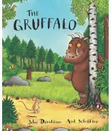
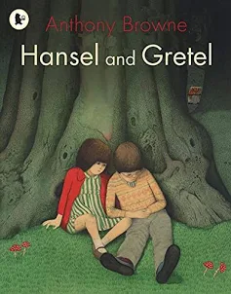
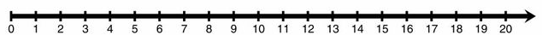
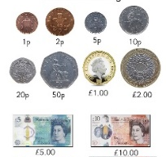
ENGLISH
Class Text: The Gruffalo by Julia Donaldson; Hansel and Gretel by Anthony Browne
Year One will begin to/Year Two will:
Explain a simple sentence is a complete idea.
Explain a compound sentence contains two complete ideas.
Identify compound sentences.
Identify subject and verb in simple and compound sentences.
Identify when a ‘sentence’ is missing a subject or verb.
Write simple and compound sentences as statements and commands.
Write compound sentences using but, and, so.
Write instructions.
Farcet C. of E. Primary School Curriculum Overview: Autumn 1
SCIENCE: THE HUMAN BODY
We will learn:
To identify, name, label and draw the basic parts of the human body.
To identify and label parts of our body relating to our senses.
To know senses help us to understand the world around us and keep safe.
To know our bodies, including our muscles and bones, need exercise to stay healthy.
To know our digestive system takes nutrients from food to help us stay healthy.
To know keeping clean stops germs from spreading and keeps us healthy.
Working Scientifically:
• asking simple questions/identifying and classifying
using their observations and ideas to suggest answers to questions
identifying and classifying- identifying and classifying/gathering and recording data to answer questions
Year Group: 1 and 2 – Goodall Class
Maths
Year 1:
Count, read and write numbers to 10
Count forwards and backwards within 10 from any number
Given a number, identify 1 more and 1 less
Identify and represent numbers using objects and pictorial representations including the number line, and use the language of: equal to, more than, less than (fewer), most, least
Familiarise themselves with part-part-whole diagrams
Read, write and interpret mathematical statements involving addition and equals signs
Year 2:
Read and write numbers to at least 100 in numerals and words
Recognise the place value of each digit in a two-digit number
To partition a two-digit number into tens and ones.
Use place value and number facts to solve problems
Count in steps of 2, 3 ,5 and 10 from any given number
Compare and order numbers from 0 to 100; use <, > and = signs
Recall and use addition and subtraction facts to 20 fluently, and derive and use related facts up to 100
Add and subtract numbers using concrete objects, pictorial representations, and mentally
COMPUTING: TECHNOLOGY AROUND US
We will learn to:
Identify technology
Identify a computer and its main parts
Use a mouse in different ways
Use a keyboard to type on a computer
Use a keyboard to edit text
Create rules for using technology responsibly
Physical Education
Multiskills
GEOGRAPHY: Spatial sense- mixed age plan.
We will learn to:
Understand what an ariel map is, and label a familiar map
To understand what a compass is used for and label N,S,E,W compass directions
To study an OS map of our local area- Farcet in Peterborough
To understand the vocabulary ‘physical’ and ‘human’ features
Fieldwork- to visit our local area, recognising main features a cartographer would include on a map.
To create our own maps, including a title, symbols, a key and compass points.
PSHE: Cambridgeshire Syllabus
Myself and my relationships.
BB12- Beginning and belonging
ME12- Me and my emotions,
RE – WHO IS GOD TO CHRISTIANS AND WHY DOES GOD MATTER TO THEM?
In this unit, pupils will explore more about Christian concepts of God. This will include shared beliefs about God as creator. They will also consider how different Christians might
express their beliefs about God differently.
Knowledge we will cover in this unit:
Christians believe in one God who created the world
The Bible is a key source of authority for Christians
The Bible is a collection of books written at different times and in response to different situations
Different Christians live out their beliefs differently
MUSIC: Marching Music
We will learn to:
To understand what a beat/pulse is, and to understand that they can be played at different speeds. To know the role of a musical conductor.
To understand how we can make music in different ways- the different sounds of body percussion compared to different instruments.
To understand the difference between a pulse and rhythm, and that they can be played in unison together.
To evaluate our musical performance and consider what we achieved and what we found tricky.
Artist study- Mozart, Verdi.
ART: Colour
We will learn to:
Recognise and name primary, secondary, warm and cool colours
Make tints and shades by adding white and black paint
Use a paintbrush with good control
Collage a small area using tissue paper and craft materials
Use wax resist and paint to create a desired effect
Use a different range of brushstrokes, e.g. rough and short for the sea
Artist study- Monet, Mondrian, Bruegel, Vermeer

