Slide 1


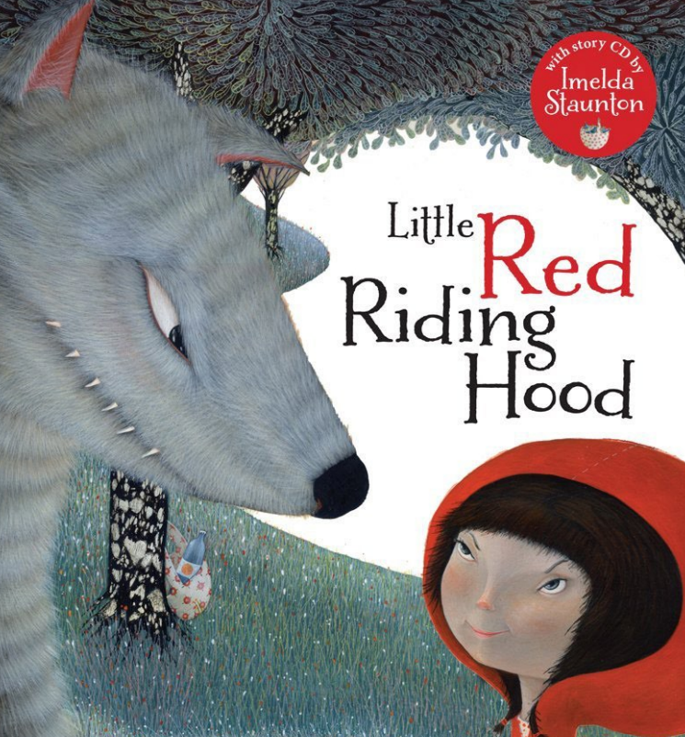
Literacy: Little Red Riding Hood by Lari Don
We will learn about:
fiction & non-fiction texts about space
emergent writing; encourage short words or phrases in different writing contexts, e.g. in free flow or in a structured lesson.
focus on letter formation in line with handwriting policy - Debbie Hepplewhite
list writing
reading words through sound blending as part of our sounds-write SLP scheme
embedded within the provision - opportunities for emergent writing (with ongoing provision for mark making) e.g. writing letters of children’s names in paint, sand, with water and brushes, tracing activities, rubbing activities, whiteboards and pens, clipboards outside etc
Phonics
continue to learn our Sounds-Write linguistics phonics programme, focusing on the initial code and blending and segmenting sounds to read and write words and sentences.
Farcet C. of E. Primary School Curriculum Overview: Spring 1 2026
Year Group: RECEPTION
Understanding the World, Science Space
know that we live on planet earth
understand that there is land and sea, animals and plants
know there are other planets in our solar system.
understand that the planets in our solar system are very different to each other.
understand that the stars we see in the sky are very far away.
Seasons: Spring
to know that Spring is one of the four seasons in a year.
to be able to identify the signs of Spring in nature.
Mathematics
Alive in 5
Introduce zero
Find 0 to 5
Subitise 0 to 5
Represent 0 to 5
1 more
1 less
Composition
Conceptual subitising to 5
Mass and Capacity
Compare mass
Find a balance
Explore capacity
Compare capacity
Growing 6, 7, 8
Find and represent 6, 7, and 8
1 more
1 less
Composition of 6, 7 and 8
Make pairs-odd and even
Double to 8 (find a double)
Combine 2 groups
Conceptual subitising
Length and Height
Explore and compare height
Explore and compare length
Communication and Language
Use different tenses to discuss things that are happening now and things that happened in the past, and things that happened a very long time ago.
Ask relevant questions to find out more information e.g. when sharing a non-fiction text children can say ‘I wonder why…’
Build up vocabulary that reflects knowledge and experience e.g., children can talk about space, what they know about it, what an astronaut does, how we know about space.
Share opinions, explaining preferences e.g. My favourite planet is… because…
Understanding the World, Computing
Use technology within the provision – IPads
To know and talk about the different factors that support their overall health and wellbeing – sensible amounts of ‘screen time’
Personal, Social and Emotional Development
Healthy and Safer Lifestyles 2 –
Keeping Safe (includes Drug Education)
RE: What stories are special to different people?
What books/stories are special to us?
The Bible is special to Christians
Stories from the Bible – Noah’s Arc, The Creation Story
Where is the Bible kept in a church?
The Qur’an is special to Muslims
Stories from the Qur’an – The Creation Story, The Sleepers in the Cave.
Where is the Qur’an kept in a mosque?
Physical Development
Multi skills
Forest school
Gross Motor Skills:
Invasion games, throwing and catching
Balance- standing on one leg, walking along a bench, climbing.
Fine Motor Skills:
Small tools; cutlery, tweezers, pipettes, scissors
Drawing and painting,
Understanding the World, History and Geography
Space
to know that people who travel into space are called astronauts.
to understand astronauts live and work on the international space station.
people have told stories about the stars for many years.
to know that astronauts have walked on the moon.
to understand that the mars rover is a robot exploring the planet mars.
Expressive Arts and Design
to explore making marks- different types of lines. To explore lines and take a line
for a walk.- Miro
to create drip paintings inspired by Jackson Pollock- class canvas.
to create art inspired by Hundertwasser using spirals and curved lines.
to explore weaving techniques
to explore music and emotions

