Slide 1
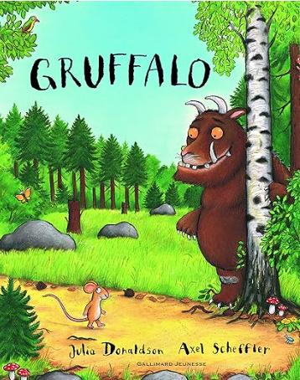


Literacy: The Gruffalo by Axel Sheffler
We will learn about:
Fiction including picture books with familiar settings, relating to families, people who help us.
Oral retelling of familiar stories using own words and recently introduced vocabulary.
Story language; becoming familiar with phrases like ‘once upon a time’, ‘a long time ago’, ‘lived happily ever after’.
Use puppets to retell familiar stories.
Poetry; learning and reciting simple poems with rhyme and repetitive language
Provide opportunities for mark making; stamps in playdough, wheels and other shapes for stamping into playdough, carving into fruit and vegetables. Upright mark making such as an easel, a tuff tray on its side, painting with water onto walls, window paints etc.
Focus on letter formation in line with handwriting policy – Debbie Hepplewhite
Phonics
Initial sounds and simple CVC words in line with Sounds-Write our SSP scheme
Farcet C. of E. Primary School Curriculum Overview: Autumn 1
Year Group: RECEPTION - All About Me!
Understanding the World, Science – All About Me!
The human body: Facial features, body parts, the senses
Seasons: Autumn
Deciduous and evergreen trees. Observing leaves using magnifying glasses, leaves changing colour.
Mathematics
Match, Sort and Compare
Match objects
Match pictures and objects
Counting forwards
Compare amounts
One more
One less
Compare numbers
Compare objects
Sort objects to a type
Explore sorting techniques
Create sorting rules
Talk about Measure and Pattern
Compare size
Compare mass
Compare capacity
Explore simple patterns
Copy and continue simple patterns
Create simple patterns
Communication and Language
Listen to others one on one or in small groups, e.g. talk about families in circle time and share pictures.
Join in with repeating refrains and anticipating key events and phrases in rhymes and stories e.g. in songs, poems, familiar stories, call and response games.
Understand use of objects and tools in the classroom e.g. children know what they can do during independent free flow time, they know how to select the tools they need to make a junk model, to write a letter to someone etc.
Respond to multi-step instructions e.g. first we need to put our coats on, then we need to zip them up, then we will get ready to go out to play.
Retell past events from stories and from own experience in chronological order; e.g. describing a day at school, describing what they did at the weekend, talking about what happened in a story.
Understanding the World, Computing
Use technology within the provision – IPads
To know and talk about the different factors that support their overall health and wellbeing – sensible amounts of ‘screen time’
Personal, Social and Emotional Development
Myself and My Relationships 1 - Beginning and belonging
Myself and My Relationships 3 – My emotions
Physical Development
Multi-skills
Forest school
Gross Motor Skills:
Spatial awareness and multi step instruction games
Running, jumping, using tricycles and scooters outside with increasing control.
Fine Motor Skills:
Small tools; cutlery, tweezers, pipettes, scissors.
Cutting paper, card, fabric, tracing, using templates, playdough
Drawing myself; what features do I have?
RE: God and Creation
To know that The Bible is the Christian Holy Book
To know the creation story
To create their own music and art inspired by Haydn’s The Creation
To retell the Creation story
Understanding the World, History & Geography – All About Me!
My past, present, future and that of others including characters from stories
Families; when I was a baby, when my family members were young. Family Trees, diverse representations of family life.
Developing sense of chronology; before I was born, before I came to school, which classroom will I be in next year?
Our school year – what will we do this year in Reception?
Location of our school and the local area
My route to school; what do I pass? Do I take transport? What do we like about our local area? What would we change?
Community; this means the people who feature in our lives, our school is an important part of our community, friends, families, religious communities, people with shared interests e.g. hobbies.
People who help us in our community; including but not limited to teachers, doctors and nurses, firefighters, police, shop workers, rubbish collectors.
Expressive Arts and Design
Exploring colour. Painting with primary colours.
Mixing secondary colours.
A study of Miro.
Painting: portraits
Rhythm, Pulse and Sound
Composer: Wolfgang Amadeus Mozart, Allegro from A Little Night Music.

