Slide 1
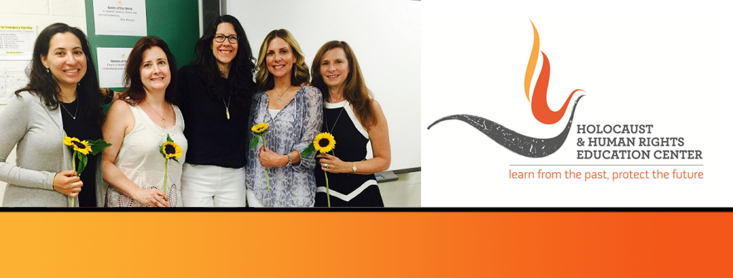

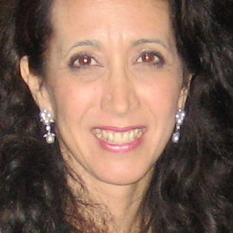
https://hhrecny.org/
Tamar Sadeh,
GenerationsForward
Tamar shares the history of the strength, bravery, and hope of her
grandmother Margit and her father Ivan and of the ordinary people who
chose to help them survive the Holocaust. When Margit and six-year-old
Ivan were in a forced labor camp their lives were saved by a man who
risked his life to get them removed from a death camp transport. Ivan was
then smuggled out of the camp and three different Christians in Slovakia
hid him at great risk to themselves. Margit was sent to Ravensbruck and
Bergen-Belsen death camps and was liberated when she was gravely ill
and wounded. Ivan’s father, grandparents, and many other family members were murdered by the Nazis. After the Holocaust Margit and Ivan started a new life in Israel. Ivan met and married Tamar’s mother Esther, whose parents survived the Holocaust by escaping Nazi Germany and helped found Nahariya, Israel.
She hopes to inspire the realization that your choices matter and contribute to history, and that history is the sum of choices made by ordinary people individually and as part of groups and governments. She seeks to impart that it is essential to reject silence and indifference, and to combat hatred, discrimination, and injustice in our local communities, nation, and world.
Tamar was born in Israel and came to the United States when she was two years old. She holds a B.A. in History from Yale University and a J.D. from New York University School of Law. She worked at Kramer Levin & Naftalis, the Anti-Defamation League's Legal Affairs Department, and Hadassah's National Domestic Policy Department, where she founded Hadassah's Amicus Brief Program. She is currently Chair of Hadassah's National Attorneys’ Council and a member of Hadassah’s National Board, National Portfolio Council.
[location]
[date]
[time]
Event held at:

