Slide 1
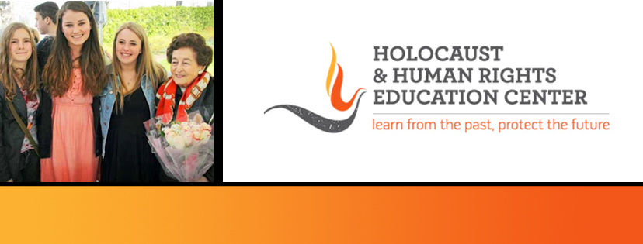

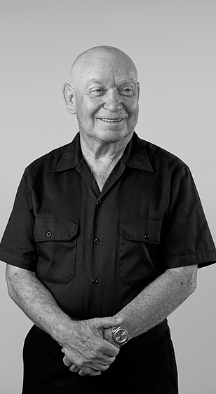
https://hhrecny.org/
Sami Steigmann,
Holocaust Survivor
He was born on December 21, 1939 in Czernovitz,
Transylvania, Romania. The city was annexed by the USSR
during World War II and is now a part of Ukraine. From 1941
through 1944, he was with his parents in the Ukraine at
Mogilev-Podolsky, a labor camp in an area called Transnistria.
The camp was liberated by the Red Army and his family was
deported by the Romanians, not by the Germans. In 1961,
the whole family (his sister was born in 1946) emigrated to
Israel. He served in the Israeli Air Force, not as a pilot. In 1968,
without knowing the language and no money, alone, Sami
came to the United States.
He lived in Milwaukee, Wisconsin where he married, divorced and eventually, in 1983 returned to Israel. However, in 1988, he returned to the United States, choosing New York City as his final home.
[location]
[date]
[time]
Event held at:

