Slide 1


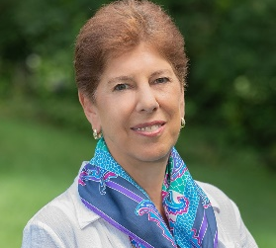
https://hhrecny.org/
Linda Broenniman
GenerationsForward
Linda Ambrus Broenniman’s presentation brings history to life, inviting
young audiences to step into the world of 19-year-old students Clara Ambrus and Eva Fischer on the brink of the Nazis’ Final Solution in 1944. Would they have the bravery and compassion to save their best friend?
In 1944, as the Hungarian government began rounding up Jews for transportation to Auschwitz, 19-year-old Catholic medical student Clara Ambrus made a life-changing offer to her Jewish best friend, Eva Fisher.
Linda shares her mother Clara’s story of her friendship with Eva, as they remained best friends throughout their lives, and achieved success working in the medical field. It is part of a larger narrative, The Politzer Saga, a book that illuminates what is lost when we allow hatred and prejudice to threaten our lives and erase our history. Her presentation is more than a lesson from the past, as it cultivates critical thinking, social responsibility, and civic engagement – qualities essential for navigating today’s challenges.
[location]
[date]
[time]
Event held at:

