Slide 1


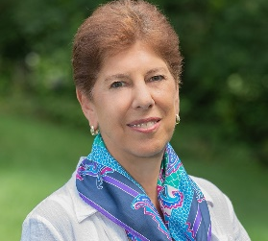
https://hhrecny.org/
Linda Broenniman
GenerationsForward
Linda Ambrus Broenniman’s presentation brings history to life. It starts
with a housefire in 2011. The contents of a box that survives become the catalyst for a quest whose seeds were planted in 1983 – the day Linda learned that her Catholic father was Jewish and what little family history she knew was a lie.
Searching for truth, Linda pieces together the astonishing story of her Jewish ancestors—the Politzer family—their remarkable lives lost to her father’s secrets. From the Austro-Hungarian Empire in the 1700s to modern day Hungary and America, she finds her family and learns of their resilience in surviving religious persecution, wars, epidemics, and economic upheavals. This story is about her discoveries and revelation that her mother had collaborated to save her best friend and her family from deportation to Auschwitz, and in the process rescued a number of other Hungarian Jews, including the man who would become her husband.
[location]
[date]
[time]
Event held at:

