Slide 1


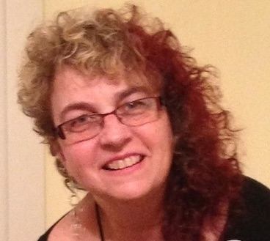
https://hhrecny.org/
Lea Weinberg,
GenerationsForward Speaker
Lea Weinberg is a second generation to Holocaust Survivors Paula
and Mordechai Fried.
Her father’s Journey from Transylvania to Auschwitz, to more
concentration camps, death march and liberation from Dachau. After
the war, luckily found his 3 sisters who also survived. He came to Israel
on a boat that was sent to Cyprus by British soldiers. Later, joined the Israeli army, was
wounded in a battle near Jerusalem; at the hospital, met Paula, who was a nurse.
Her mother Paula (Gelb) was sent from Czechoslovakia to Auschwitz-Birkenau where she lost her parents and siblings, worked, at 18, as a Clothes’ Sorter near the crematoria. After the war came to Israel to build a new life and a new family; bringing to life the memory of her lost family through the nostalgic and vivid stories she told.
Lea speaks about her optimistic mother inspired by the special story about 8 photographs of her family which she came upon in Auschwitz-Birkenau and how she was hiding them.
Lea is preserving the stories she has personally heard in a few different ways:
A talk about her mother’s story; A poem she wrote: “Memories in the Air”
As an Artist Sculptor Lea is also expressing Holocaust in Contemporary Art through an ongoing project installation MOTHER-SURVIVOR a woman’s Personal Story intertwined with the Shoah History
Lea was born and raised in Israel; since 2005 lives with her husband and younger daughter in White Plains, NY, their older son and daughter lives in Israel.
Event held at:
[location]
[date]
[time]

