Slide 1


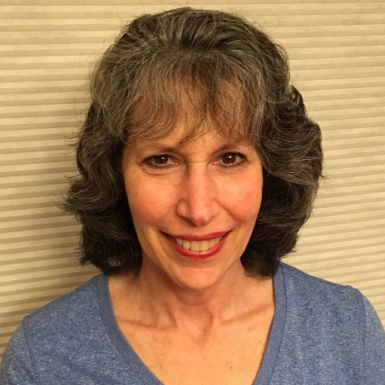
https://hhrecny.org/
Joan Poulin,
GenerationsForward Speaker
Joan Poulin is the daughter of a Holocaust
survivor. Her father was 23 when he left
Hamburg, Germany for New York in 1938,
leaving his mother and brother behind. While
her father never spoke about the Holocaust, he
left behind 175 letters from his mother and brother which allowed Joan to piece together his story. Hear not only his story, but how being a child of a Holocaust survivor has impacted her life and the life of her family.
Joan lives in NY with her husband, Steve, and they have two children. Joan works at a financial planning office.
Event held at:
[location]
[date]
[time]

