Slide 1
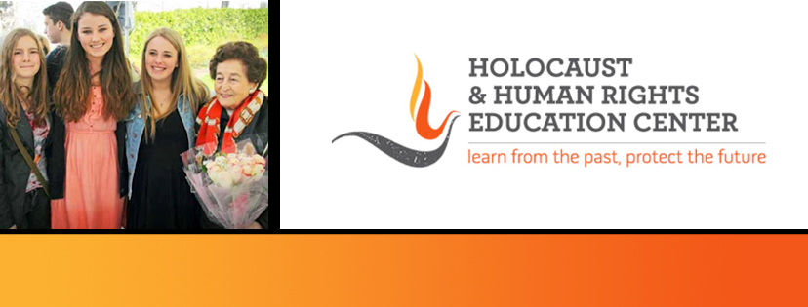

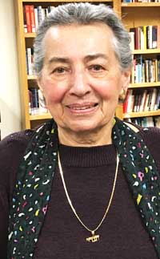
https://hhrecny.org/
Helga Luden,
Holocaust Survivor
Helga Luden was born in 1934 in Ulmen, a town in the Rhineland
region of Germany. Helga’s family was the only Jewish family in the
town but members of the Luden family had lived there since the
1800s. In 1939 Helga was sent with her mother to Gurs transit camp
in the Basque region of southwestern France. While in the camp, her
mother taught her how to make a quick escape if necessary and one
night she was forced to so. Helga escaped to the woods where she
was found by French-Jewish partisans and brought first to a convent and then to an orphanage. Helga’s mother found her there well taken care of, then they were taken in by a Catholic family near Marseille. They were eventually put on a boat, the Serpa Pinto, to the United States via several stops in North Africa where they were reunited with Helga’s father who had been in a slave labor camp. When the boat reached New York, it was not allowed to dock. The only country which would take the refugees in was the Dominican Republic. Her family settled in the seacoast town of Sosua, where Helga’s sister was born in 1942. The family was not able to come to the United States until 1946.
[location]
[date]
[time]
Event held at:

