Slide 1
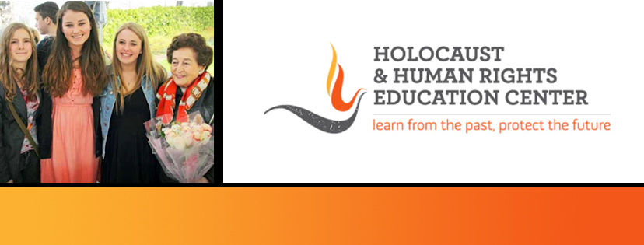

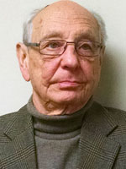
https://hhrecny.org/
Endre (Andy) Sarkany,
Holocaust Survivor
Endre (Andy) Sarkany was born in Budapest, Hungary on October 31, 1936.
The building he lived in was located inside the Budapest ghetto which is where
he remained during the Holocaust. The building housed a nursery/kindergarten
on the ground floor. The school was affiliated with the Jewish Agency of
Hungary and was led by Mr. Eugene Polnay. The building also housed on the
top floor a dance, acrobat and ballet studio. These facts were significant in
Endre’s survival and that of at least 150 orphaned children. Endre’s father was
taken to Mauthausen concentration camp in the spring of 1944, fortunately he
survived.
After WWII, Hungary became a communist nation. Although Endre graduated high school in 1955, he was not accepted to university because he was deemed an undesirable element of society. This label was given to anyone who owned a business before the communists took over the country.
Endre was fortunate to escape Hungary after the October 1956 uprising and was able to immigrate to the United States. He received his bachelor’s degree from Tusculum College in Tennessee and his Master of Science degree in Applied Mathematics and Computer Science from Washington University in St. Louis, Missouri. Endre worked for both the McDonald Douglas Corporation and the IBM Corporation.
Over the past 10 years, Endre has been speaking to students about his personal experiences during the Holocaust, living under the brutality of the Soviet regime in Hungary, and finding a home in the United States.
Mr. Sarkany is married, has a daughter and son, and five grandchildren.
[location]
[date]
[time]
Event held at:

