Slide 1
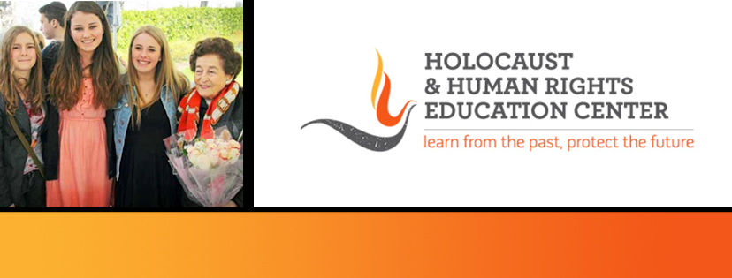

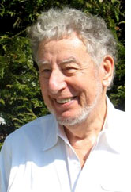
https://hhrecny.org/
Ed Lessing,
Holocaust Survivor
Ed Lessing was born in Holland. He and his whole
family went into hiding from 1942-1945. At first he
posed as a Christian and worked on farms. Later he
joined the resistance and lived in a hut in the forest.
He had a narrow escape when the German storm
troopers raided the forest. After liberation, he
continued to live in Holland until he came to the US in
1947.
Mr. Lessing's presentation covers life in Holland after the occupation, his experience in several hiding places, as a resistance fighter living in the forest, and life in Holland after liberation. Mr. Lessing has lectured on TV and Radio in the US and Holland, has interviewed for the Spielberg Shoah Foundation and writes for the Hidden Child Foundation. He speaks in schools and numerous organizations.
[location]
[date]
[time]
Event held at:

