Slide 1
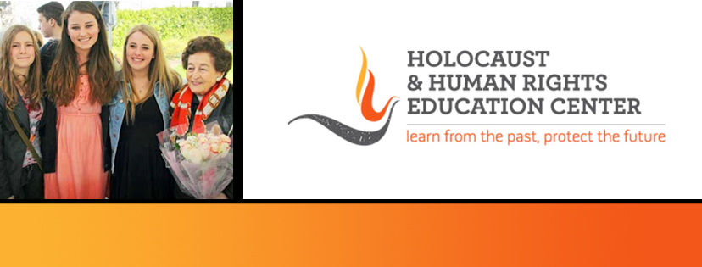

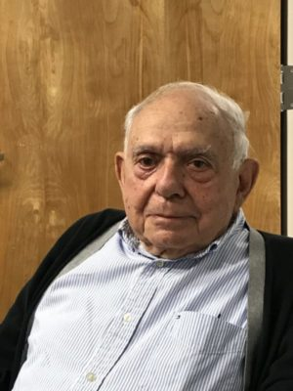
https://hhrecny.org/
Dr. Manfred Simon,
Holocaust Survivor
Dr. Manfred Simon was born in Cologne, Germany in
1928. As a young boy, he was a witness to the development
of the Nazi anti-Semitic surge of the 1930s. After attending
a public school, he was forced to attend a Jewish day school
not long after the Nazis came to power. His father began
working on plans as early as 1936 to escape Germany but
he soon learned how difficult and expensive a process it
would be.
Even with the help of relatives who lived only 10 miles from the
Dutch border, it took over two years to safely leave Germany. After a brief stay in London, Dr. Simon, his mother and his father sailed to the United States on board the USS Harding on March 13, 1939. Upon arrival, his family settled in Washington Heights.
Dr. Simon attended medical school and became a gastroenterologist. He currently lives with his wife, Susanne, in Edgemont. They have three sons and seven grandchildren.
[location]
[date]
[time]
Event held at:

