Slide 1
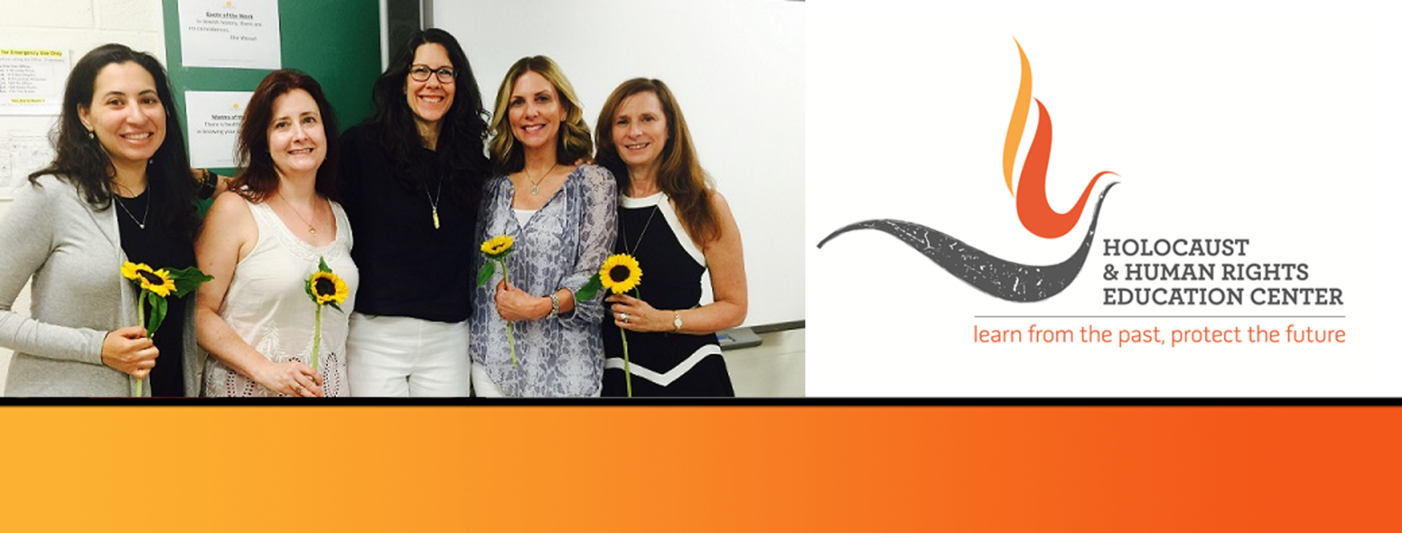

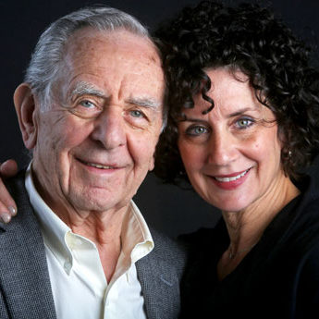
https://hhrecny.org/
Audrey Unger Reich,
GenerationsForward
Audrey’s father, Ron (Romek) Unger, grew up in the southern
Polish town of Tarnow. His life changed abruptly at age 11, when
the Nazis invaded Poland in September 1939. He lived under
ever-increasing restrictions and brutality until he was deported to
Plaszow, the first of three concentration camps he was sent to
during the War. He was liberated from Ebensee (a satellite camp to
Mauthausen) on May 6, 1945, only months after his father died of
infection and malnutrition. Ron’s mother was murdered at Auschwitz. Ron spent more than three years in a displaced persons camp in Italy until emigrating to the United States in December 1948.
Audrey visited Poland in 2014 and was able to find her father’s home in Tarnow, as well as the building where his family’s business had been. She also visited Zbylitowska Gora, a forest outside of Tarnow, where, in June 1942, 6,000 Tarnow Jews, including 800 children, were shot by German soldiers and then buried in mass graves.
Audrey is an artist and educator, who tells her father’s Holocaust story, and has created artwork inspired by it. Ron is involved in the “Adopt-a-Survivor” program on Long Island. They hope to ensure that the horrors of the Holocaust, and the personal stories of the survivors, will never be forgotten.
[location]
[date]
[time]
Event held at:

