Slide 1
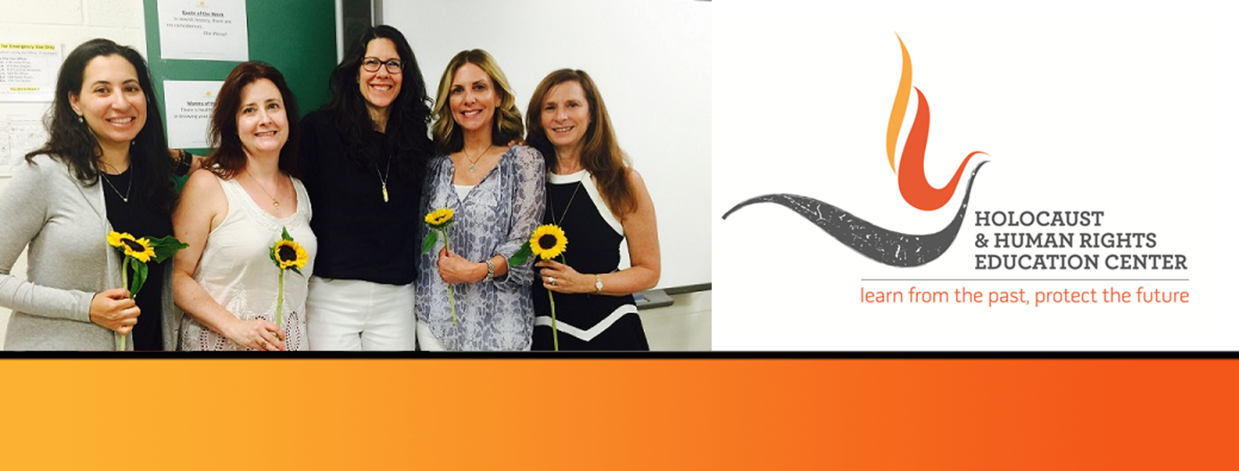

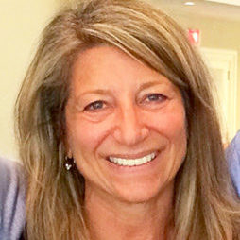
https://hhrecny.org/
Anita Greenwald,
GenerationsForward Speaker
Anita Greenwald is the daughter of two Holocaust survivors.
Her father was only 12 years old when the Nazis arrived in his
Polish town of Tomasev Lubelski and sent him to Siberia,
resulting in heart-breaking loss and a lifelong commitment to
family, Israel and making a good life. Her mother was only 5
years old when she was taken from her German home to Camp
Gurs, France, and was just the beginning of her journey of devastation and miracles. Anita will tell her father’s/mother’s story and share how being a child of a Holocaust survivors has impacted her life.
Anita lives in Armonk, NY with her husband, Richard and they have two childen that are launched and two in college. Professionally, Anita has started successful organizations that continue to thrive, in both the corporate and the non-profit world.
Anita is a member of GenerationsForward, a group of second and third generation individuals sponsored by the Holocaust and Human Rights Education Center of White Plains, New York.
Event held at:
[location]
[date]
[time]

