Slide 1
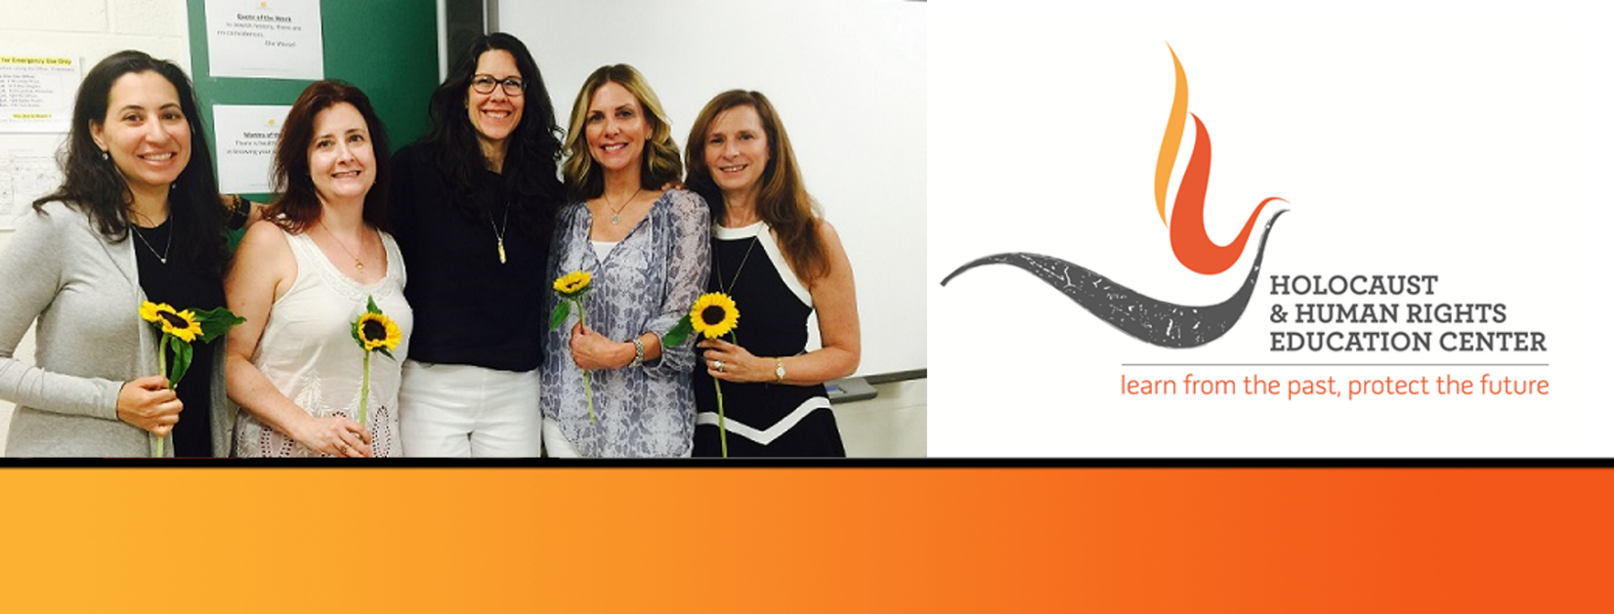

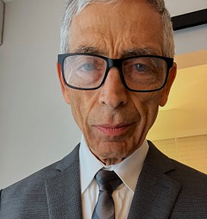
https://hhrecny.org/
William Zimmerman,
GenerationsForward Speaker
William is the son of Holocaust survivors Frieda and Morris
Zimmerman, Polish Jews from small towns who survived work
camps, ghettos and concentration camps during the Holocaust.
William tells the story of their perilous journey that culminated in 1950 with their arrival in America. He also describes his pilgrimage to Poland with his parents and other family members in 2005. A second trip, sponsored by the HHREC in 2022, included a visit to the Buchenwald concentration camp 77 years after his father’s liberation from the camp. William has been an educator for over 50 years. Following 36 years in the K-12 domain, he has continued his career at Pace University where he supervises Education majors in their fieldwork placements and at SUNY Purchase where he teaches undergraduate math courses. He also works as a Gallery Educator at the Museum of Jewish Heritage in Manhattan where he conducts student-oriented tours of the exhibits “The Holocaust: What Hate Can Do” and "Courage to Act: Rescue in Denmark."
[location]
[date]
[time]
Event held at:

