Slide 1
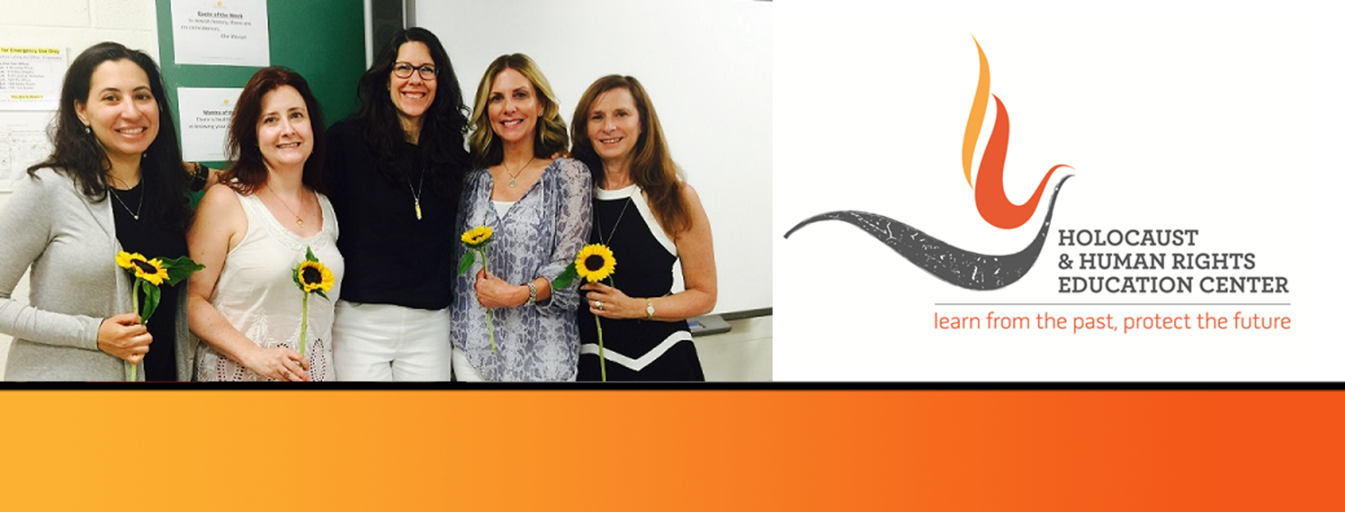

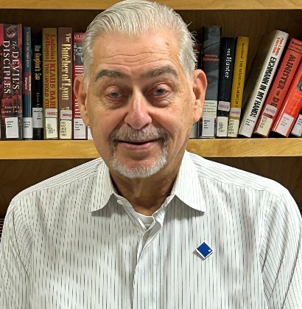
https://hhrecny.org/
Dr. Victor Borden,
GenerationsForward Speaker
Dr. Victor Borden is the son of Holocaust survivors Rywen (Roman) and Mina
Bornsztajin (Bronstein). Victor shares his parent's story of surviving Jewish
persecution in Poland under Nazi Occupation and in the Soviet Union under
Stalin.
Rywen and Mina were born and raised in Lodz, Poland, an industrial city with a large Jewish population, and they came from prosperous families. They married in 1938, a year before the world changed when Germany invaded Poland. A few days after the invasion, Victor's father attempted to flee on foot eastward to the Soviet Union, where they were forcibly relocated to slave labor camps in Siberia. What followed is a uniquely amazing story that offers chilling details of Victor’s parents journey starting in Poland, surviving imprisonment in the Soviet Union, and eventually immigrating to the United States to see their son enlist in the U.S. Air Force and serve as a physician.
Dr. Victor Borden is a member of GenerationsForward, a group of second and third generation individuals sponsored by the Holocaust and Human Rights Education Center of White Plains, New York.
Event held at:
[location]
[date]
[time]

