Slide 1
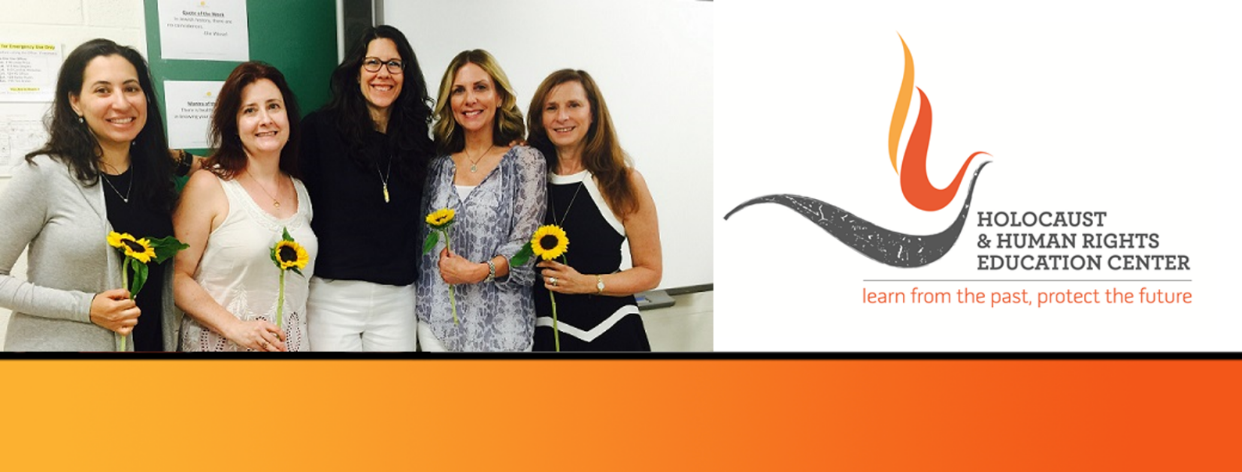

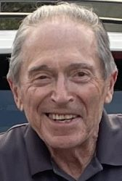
https://hhrecny.org/
Stephen Felton
Holocaust Survivor
Stephen Felton was born in the Warsaw Ghetto in June, 1942. He and
his mother, Eva, were the only survivors of a large family. Shortly
before the Warsaw Ghetto uprising in April, 1943, Stephen and his
mother were smuggled out; his father, Victor, and brother, Stasio, were sent to the concentration camp, Auschwitz, and then killed. Stephen and his mother found refuge with a Polish Catholic family until the end of the war. Eva remarried another survivor in Paris in 1946. The three of them immigrated to the United States in 1947.
Stephen earned both a Ph.D. in Chemistry and a M.D. degree, and became a practicing ophthalmologist in Princeton, N.J. He published his mother's memoirs entitled: I Shall Lead You Through the Nights. Stephen and his mother had the Polish family who rescued them, recognized and honored as "Righteous Among the Nations" at Yad Vashem, the World Holocaust Remembrance Center in Jerusalem.
[location]
[date]
[time]
Event held at:

