Slide 1


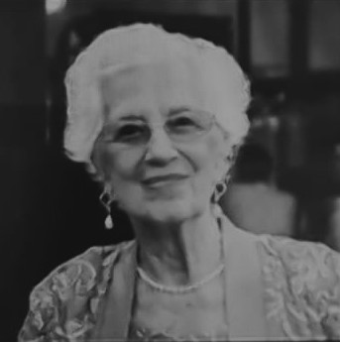
https://hhrecny.org/
Sonja Geismar
Holocaust Survivor
Sonja Maier Geismar was born on February 16, 1935 and lived in a small town near the city of Karlsruhe in southwest Germany. As a four-year-old she witnessed Nazis barging into their home on Kristallnacht, November 9, 1938 to destroy property. Sonja and her mother were frightened. When Sonja saw that her father’s photograph had been torn, she thought he had died. In truth, her father had been taken away earlier that day to the concentration camp Dachau, near Munich. There he was humiliated and beaten until he was released after five weeks. Sonja’s maternal grandparents were murdered in the extermination camp Auschwitz-Birkenau.
Sonja shares her spellbinding story of how she and her family survived by escaping to freedom with the help of the Captain of the SS St. Louis on a ship whose voyage of the” doomed, damned, and double-crossed” took them on a slow and circuitous route back to Europe and, eventually, on another ship to America. Though they arrived penniless, their perseverance and work ethic helped them slowly integrate into American society as they clung to their Jewish values.
[location]
[date]
[time]
Event held at:

