Slide 1
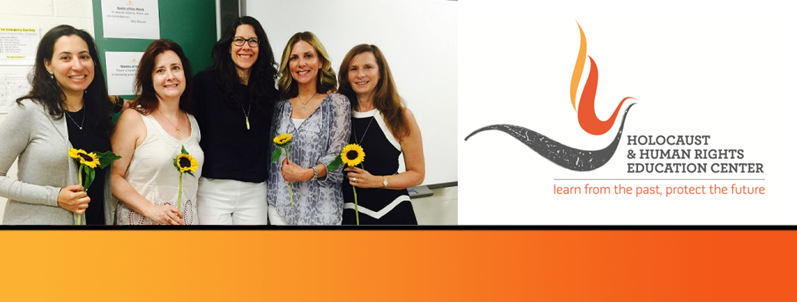

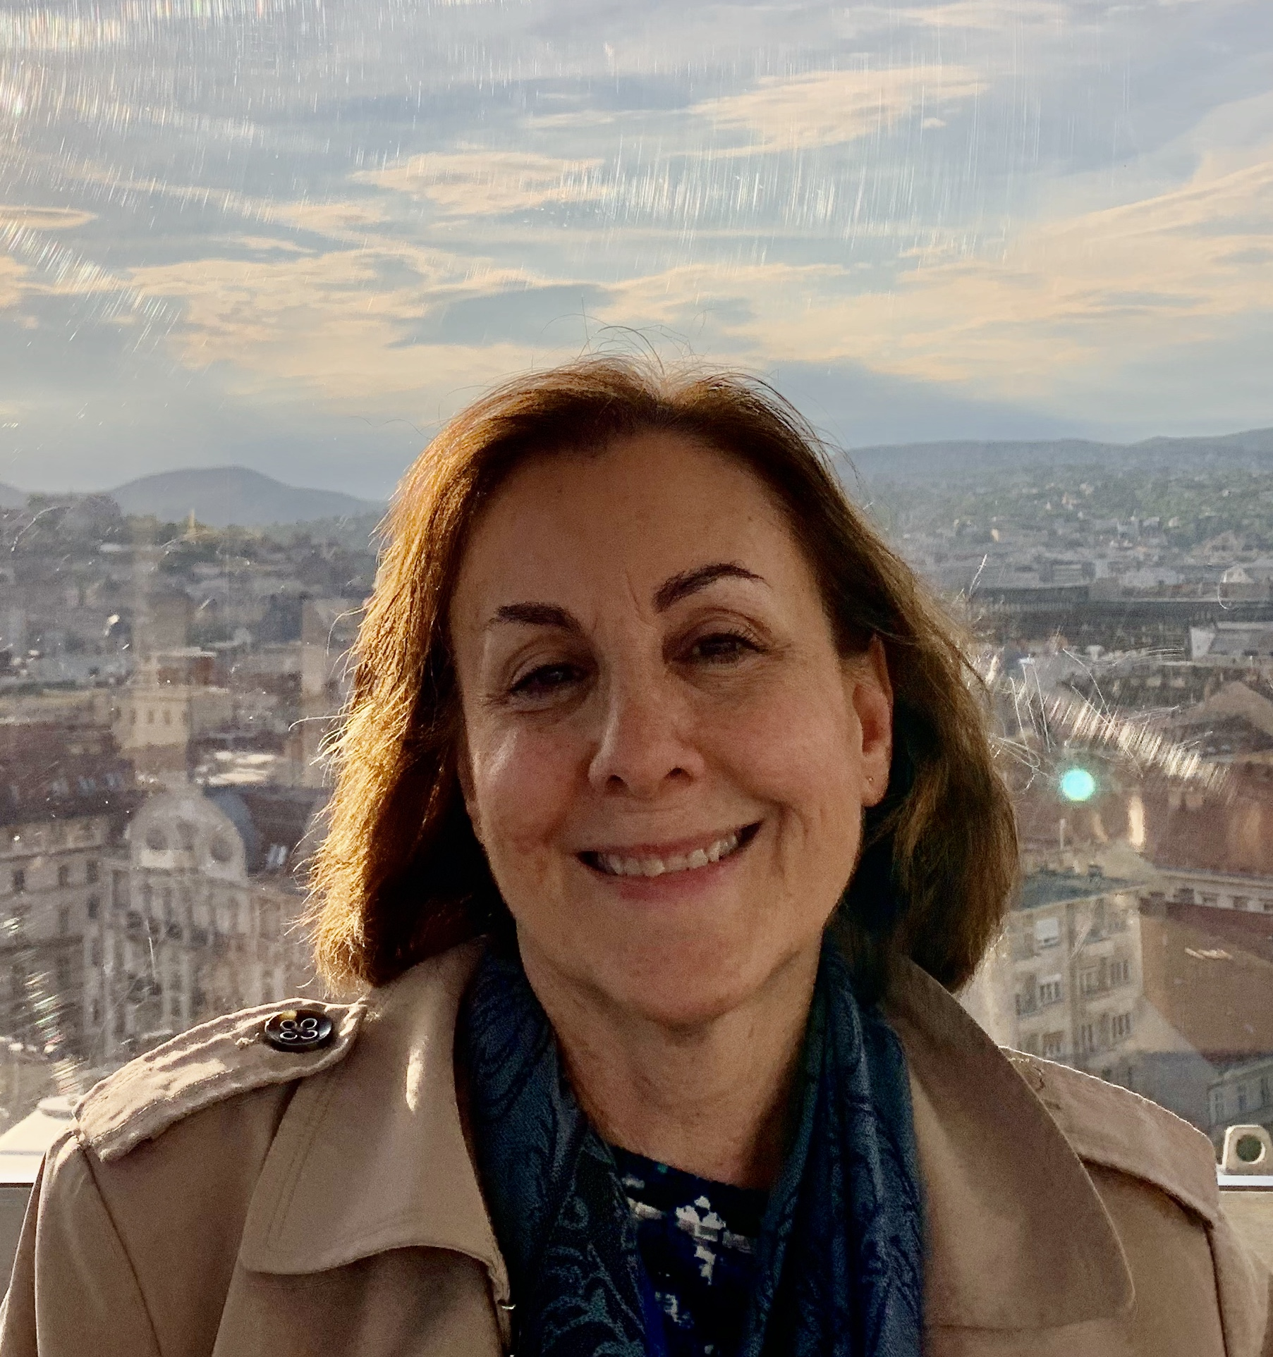
https://hhrecny.org/
Shelley Greenspan,
GenerationsForward Speaker
Shelley is the only child of two Holocaust survivors who
came from Northern Transylvania, in present-day Romania.
Shelley tells the story of her mother, Lilly, who survived two
concentration camps thanks to the love and support of her
older sister, Sarah, who was with her throughout the war.
Shelley and her daughter, Emily had the opportunity to visit
Romania in May 2019 through Tarbut Foundation Sighet to
commemorate the 75th anniversary of the deportation of Jews from Transylvania. While there, they traveled to the village of Borșa to see Lilly’s childhood home, which is now a post office. Shelley's younger daughter, Naomi, is the image of her grandmother Lilly.
Shelley is a member of GenerationsForward, a group of second and third generation individuals sponsored by the Holocaust and Human Rights Education Center of White Plains, New York.
Event held at:
[location]
[date]
[time]

