Slide 1
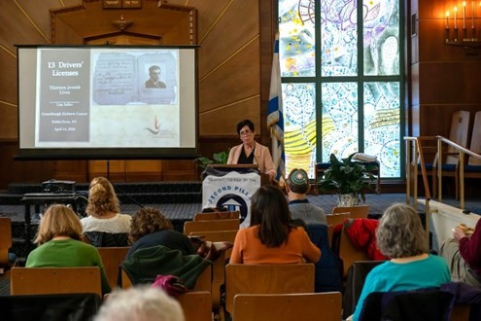



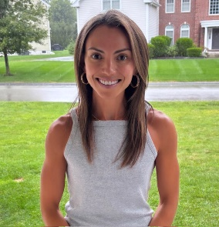
https://hhrecny.org/
Samantha Levin,
GenerationsForward
Samantha Levin is the granddaughter of the late Rabbi Mayer
Moskowitz, a Holocaust Survivor from Czernowitz, Romania. She tells the
story of how her grandfather as a young boy endured the Nazi occupation of his city and witnessed the tragic murder of his father, was forced into a ghetto and later deported to a concentration camp, from which he made a daring escape.
Her story is of his remarkable journey across Europe to the British Mandate of Palestine, and years later, the United States, and how he devoted his life to Jewish education as a teacher, principal, camp director, and cantor, touching the lives of thousands of students, including one who would become the President of Israel. Samantha chose a life of teaching and service dedicated to inspiring young minds and preserving the memory of her grandfather’s story. Through her volunteer work sharing his testimony, she continues his mission—ensuring that the lessons of the Holocaust and the call of “Never Again” live on for generations to come.
[location]
[date]
[time]
Event held at:

