Slide 1
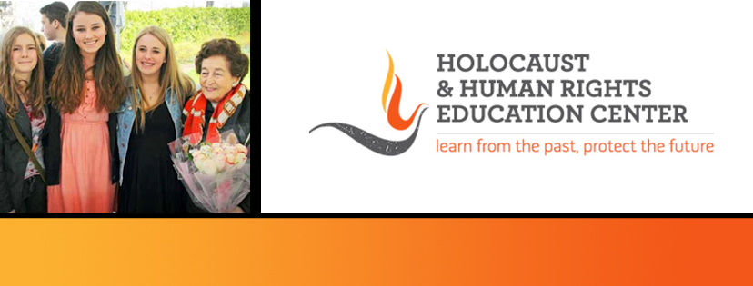

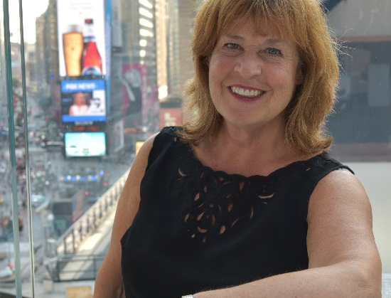
https://hhrecny.org/
Sandy Speier Klein
Sandy Speier Klein was born in the Bronx and raised in Washington Heights. Sandy spent her entire adult life in the field of Psychiatric Social Work, first as a line worker, then as a supervisor and finally as the Associate Director of Social Work at New York State Psychiatric Institute. The last 10 years of her career were at New York University Silver School of Social Work where she was a Clinical Associate Professor.
Sandy credits her Parents for inspiring her career choice. Paula and Herman Speier were immigrants. They were not JUST immigrants: they were holocaust survivors. Their life experiences were part of the reason Sandy was attracted to working with and empowering the disenfranchised people in our communities who do not have a strong voice and who need our help. Paula and Herman’s resilience and ability to rebuild their lives from nothing was inspirational.
Sandy tells two stories: that of her mother and, in addition, the story of Sandy’s search for her half- brother.
[location]
[date]
[time]
Event held at:

