Slide 1
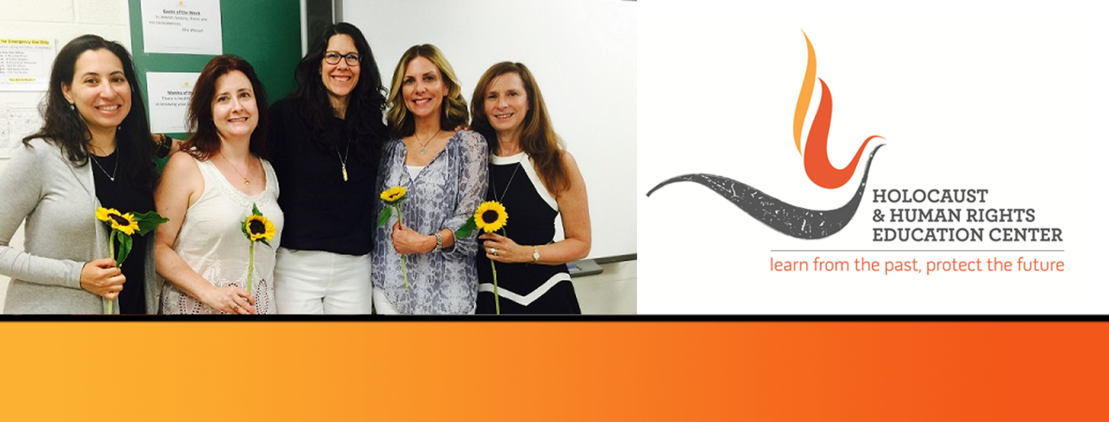

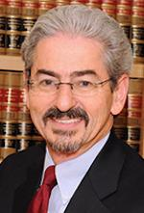
https://hhrecny.org/
Sam Rosmarin,
GenerationsForward
Sam’s mother, Mania, was 14 years when the Nazis invaded Poland
and was present when they took her parents and youngest brother. She
survived 7 labor camps in the Auschwitz complex. His father, Leo, was 18
when he was taken to a series of slave labor camps, where he spent his
“college years.” He survived 5 years in those labor camps.
Sam’s parents lived into their 80s, long enough to see all of their 6 grandchildren born.
Sam is a member of the Generations Forward community. With the guidance and support of the Center, he proudly presents Mania and Leo’s story to diverse audiences, including middle school students in California and an Orthodox congregation in New Jersey on Yom Hashoah.
[location]
[date]
[time]
Event held at:

