Slide 1
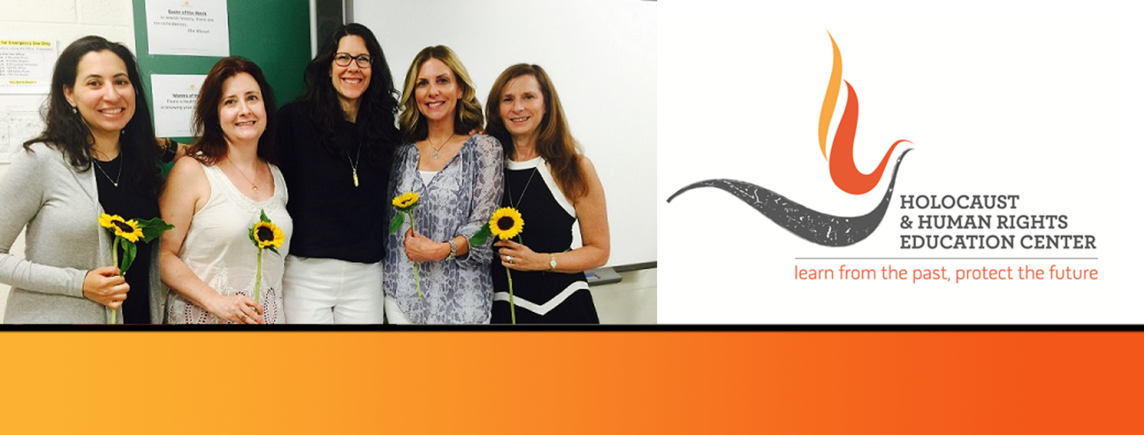

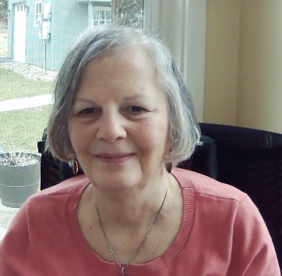
https://hhrecny.org/
Renee Pessin
Holocaust GenerationsForward Speaker
Renee Bronner Pessin, a Connecticut resident, is a descendant of two Holocaust survivors.
Originally from Brooklyn, NY, she has lived in several cities and towns over the years. Over
the years, Renee has worked as a registered nurse, editorial associate for scientific journals
and most recently, for over 20 years, as a freelance biomedical grant and manuscript editor.
Renee’s mother Helen was the only survivor of her immediate and extended family of more than 50 people In Poland. Her father Sam, along with one brother were the only survivors of their large immediate and extended family. Having met while imprisoned in concentration camp during the atrocities of the Holocaust, Helen and Sam found each other after being separated during the War. They married soon after liberation. Eventually, they immigrated to the USA to start a new life. Renee feels it is more urgent than ever to share their story, especially to community listeners, to ensure that history does not repeat itself. She is able to do so through excerpts from her mother’s video testimony to the Shoah Foundation and family pictures saved through the horrors of the Holocaust
Event held at:
[location]
[date]
[time]

