Slide 1


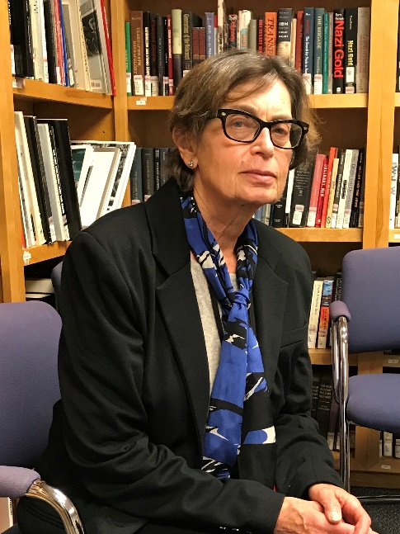
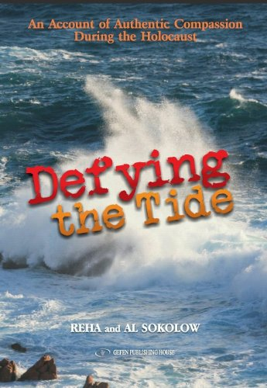
https://hhrecny.org/
Reha Sokolow,
Holocaust Survivor
Reha Solokow is the co-author of Defying the Tide: An Account of Authentic Compassion During the Holocaust
"This is a gripping history of a young Jewish mother and baby desperately hiding from Hitler, and a courageous German woman who offered her help. Fearing and facing denunciations, bombings and hunger, Ruth Abraham braved terror and despair with the help of her friend, Maria. Faith, hope and luck helped her to evade the Nazis, save her daughter, and reunite with her husband This is a poignant, detailed look at the daily life of a fugitive in war-torn Germany. We should be grateful to Ruth Abraham for sharing her poignant story with us.“
-Marion Kaplan, Professor of History, New York University
Reha is a member of the Holocaust & Human Rights Education Center Speakers Bureau.
[location]
[date]
[time]
Event held at:

