Slide 1
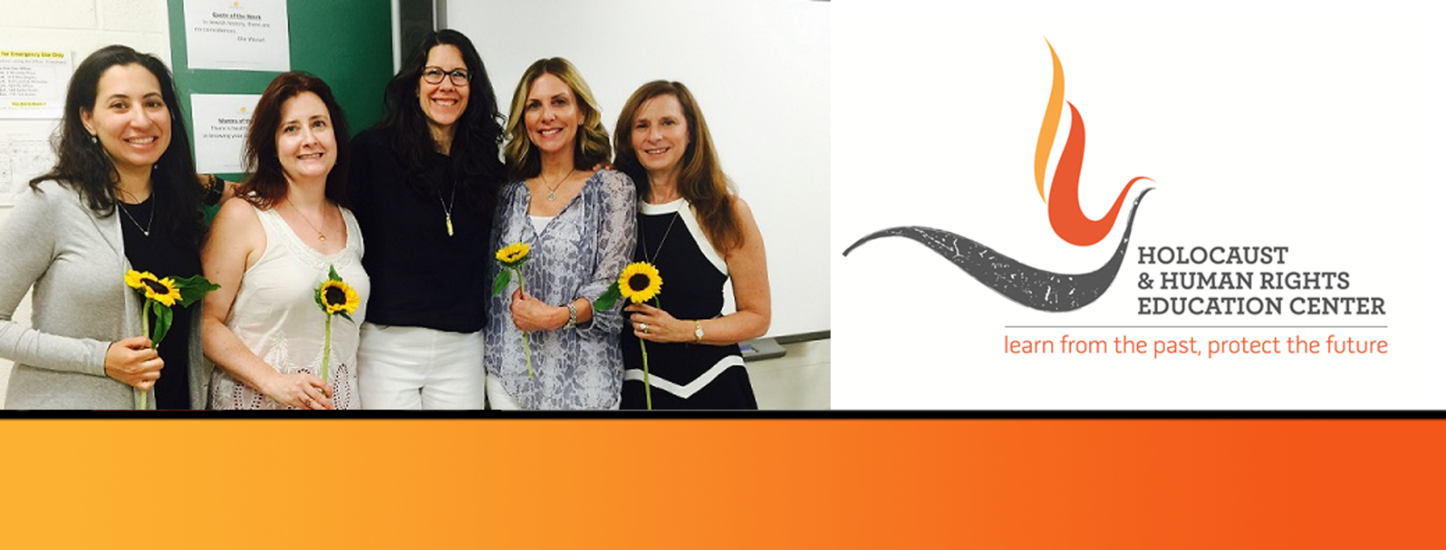

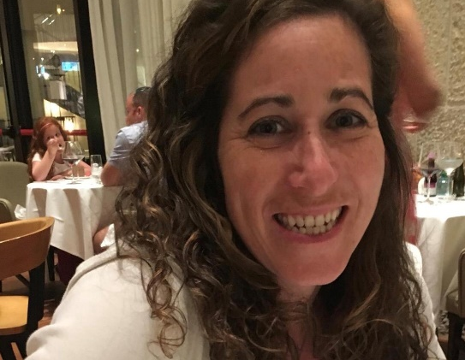
https://hhrecny.org/
Rebecca Freimann,
GenerationsForward
Rebecca Freimann is a third generation survivor. She tells
the story of her maternal grandparents and paternal
grandmother. Her maternal grandfather lost his youngest brother
and parents to the evils of the Holocaust. They were shot in a
forest outside of the Izbica Ghetto. Rebecca's maternal
grandmother escaped to England via a kindertransport. Her
paternal grandmotheremigrated before her entire family were
deported during the Zbasyn deportations, later shot in a field outside of the Bochnia Ghetto. Rebecca tells the story of how the family was separated, and how each member of her family had their own experiences and met their own fates. She authored their stories in a book entitled Family Tree: Rooted in Survival, so that her family's stories reach the masses, and her family's memories can forever be preserved.
Rebecca resides in Rockland County, where she works as a Special Education teacher. She has a background in teaching Holocaust Studies to religious school classes. Rebecca has always thought it extremely important that the stories of the Holocaust be preserved, shared, and remembered.
[location]
[date]
[time]
Event held at:

