Slide 1
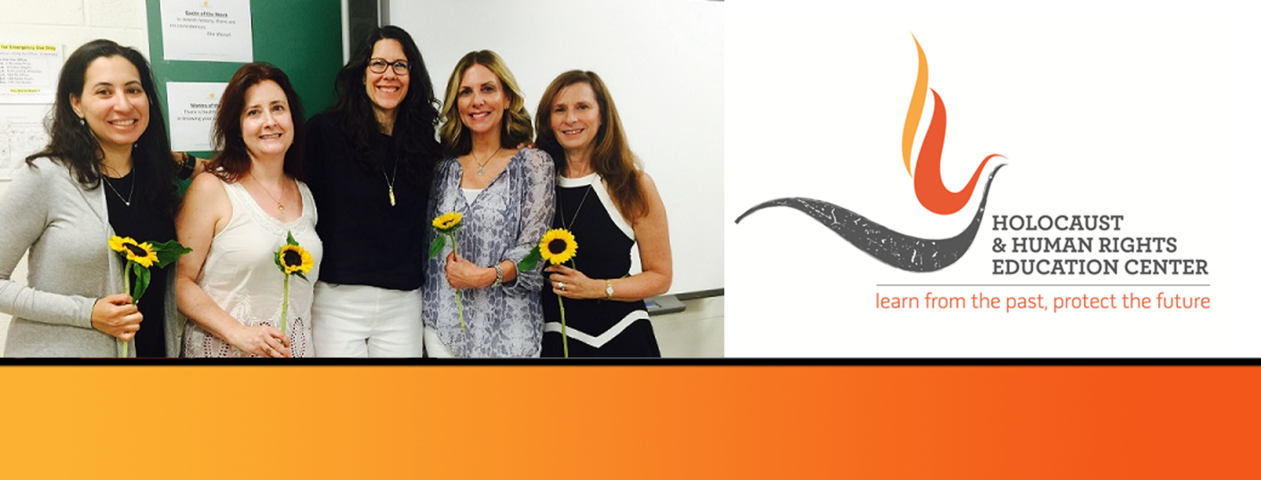

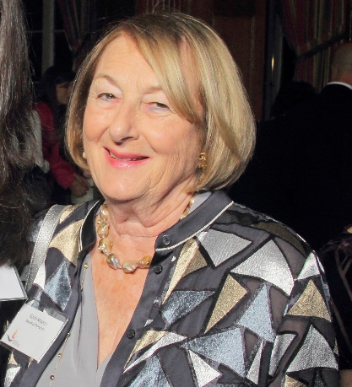
https://hhrecny.org/
Karin Meyers,
GenerationsForward
Karin Beuthner Meyers was born in Wuppertal, Germany on
June 7, 1937. Her father, an obstetrician, delivered her at home as Jews
were no longer admitted to hospitals and Jewish doctors were not
allowed to treat Non-Jews. However, Dr. Beuthner continued the care for
his patient and for this he was arrested. Later freed, Karin tells the story of
her parents’ emigration ordeal as well as the fates of other members of
her family that are pictured in a faded photograph taken the last time they
were together in the Spring of 1938. The photograph becomes a focal point of the story that Karin weaves in verse and narrative form. Her story illustrates the importance of perseverance, luck and particularly, how the good deeds of some affected her family’s outcome.
Karin Beuthner Meyers graduated with honors from Brandeis University and received a Masters of Humanities degree. She was an adjunct lecturer in Medical Ethics at Mt. Sinai Hospital in New York City and a member of its Institutional Research Review Board. Karin authored several articles on the ethics of Human Research Ethics.
Karin is a member of GenerationsForward, a group of second and third generation individuals sponsored by the Holocaust and Human Rights Education Center of White Plains, New York.
[location]
[date]
[time]
Event held at:

Slide 2
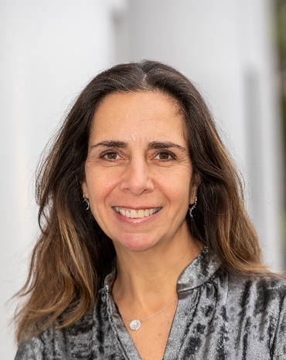
https://hhrecny.org/
Monica Mandell,
GenerationsForward
Monica is a granddaughter and niece of survivors. She grew up in a home
where the past and the present were intertwined. What was it like to be a
granddaughter and niece to survivors? The story that Monica shares is of her
aunt and grandmother who survived the war because of their fortitude,
shrewdness and, perhaps more importantly, luck. The story starts before the
war, describing a large and loving family and goes through the years of the war
chronicling how difficult it was to survive. The story also includes Monica's grandfather whose life and family interacted with Monica's grandmother and her family. The story also touches upon a few upstanders who saved Monica's grandmother's life at great expense to their own safety. The story winds itself to the present, where Monica describes what it was like to be a member of a family that combined the past with the present. Could the wounds of the war be healed? Who was responsible for healing the wounds?
Monica lives in Harrison, NY with her husband and three children. Monica is a social worker who bases her social work practice on the importance of helping others. Her decision to memorialize her family's story was not only to pass along to future generations, but to ensure that the legacy of those who died does not fade. Writing the story has become not only a blessing, but an honor to ensure that our family will live on and on.
Monica is a member of GenerationsForward, a group of second and third generation individuals sponsored by the Holocaust and Human Rights Education Center of White Plains, New York.
[location]
[date]
[time]
Event held at:

