Slide 1
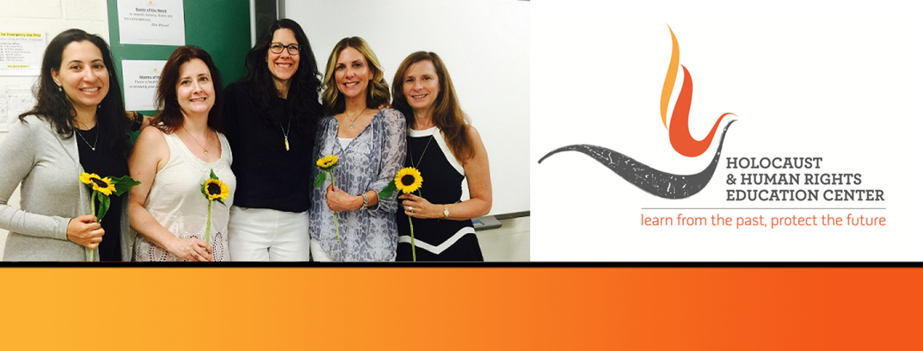

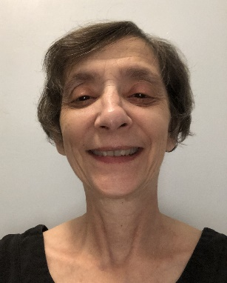
https://hhrecny.org/
Michelle Bisson,
GenerationsForward
Michelle Bisson tells the story of her mother’s journey from Budapest,
Hungary, to Lisbon, Portugal, in the middle of the Holocaust in her
children’s picture book, Hedy’s Journey: The True Story of a Hungarian Girl
Fleeing the Holocaust (ages 8+). Michelle’s mother was only 16 when she
had to travel alone through Nazi Germany in 1941, in order to escape the fate of her cousin Marika and much of her extended family, who perished in the Holocaust.
Michelle talks about how this dangerous journey alone, and the loss of one of her mother’s closest friends and relatives, as well as so many others, affected the rest of her mother’s life and that of her uncle, who was only 11 at the time. She also speaks about how other members of the extended family survived the Holocaust in Hungary, including one aunt who hid in the woods with her newborn son, now a lawyer in NYC. Michelle also talks about the effect on her life of being the child of a mother who experienced such pain. And she also talks about the pain and the pleasures of life in America after the Holocaust. Recently, she visited Budapest for the first time, and found her cousin’s and her mother’s apartment, now a Jewish history museum just over the border in what was the Jewish ghetto in the last year of World War II.
[location]
[date]
[time]
Event held at:

