Slide 1


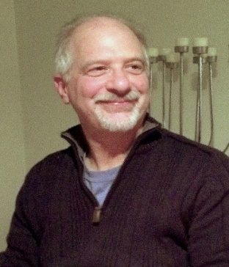
https://hhrecny.org/
Michael Gyory,
GenerationsForward Speaker
Michael Gyory is the son of Hungarian Holocaust survivors. He tells the
story of his teenage parents who were sent to concentration camps and
slave labor camps during World War II. After surviving the horrors and
torture of the war, they returned to Budapest to find that they were all
alone. They managed to fall in love, marry, emigrate to America, and have three children. It's a love story that, unfortunately, does not last for their entire lives.
Michael also shares the remarkable story of his father's first cousin, Agi Keleti. It is a story of incredible willpower and perseverance of a young woman who not only survives the Holocaust and outlasts the Communists but eventually goes on to become the greatest female Jewish Olympian champion of all time, winning 10 medals, including 5 gold. Michael presents Agi Keleti: The Jewish Olympian’s Story of Survival and Triumph accompanied by an exhibit of 6 individual panels that chronicles Agi's incredible life. To learn more, click here.
Event held at:
[location]
[date]
[time]

