Slide 1
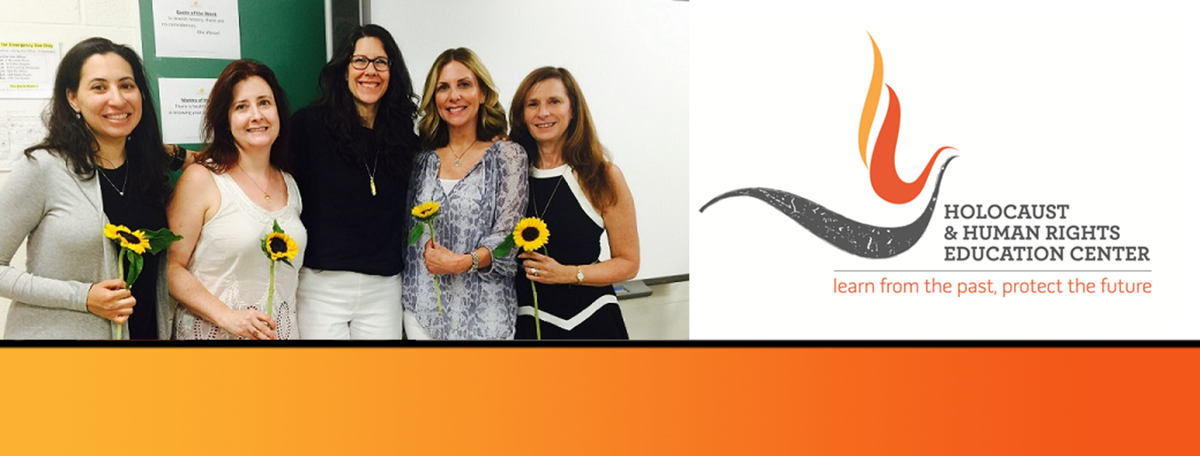

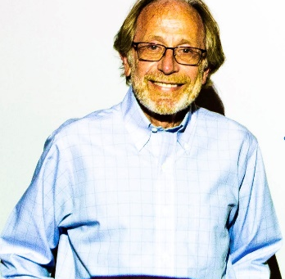
https://hhrecny.org/
Max Friedman
Holocaust GenerationsForward Speaker
Max Friedman’s parents were Polish/Jewish Holocaust survivors who met in Sweden
(where he and his sister were born) after their liberation from Bergen-Belsen.
Max tells the story of how his parents survived five years of ghettos, slave labor and
concentration camps and the loss of everyone and everything they had ever loved.
Emigrating to the U.S. in 1952, his parents spoke very little about their past – though their physical and psychological wounds were apparent every day to Max and his older sister. They didn’t want to share very much, and for him and his sister, their two children, it was enough to simply survive their survival.
Max has been telling the stories of others for his whole career — as a journalist, publicist, corporate editorial director and memoir ghostwriter. He finally got to share his own story by penning a stirring family memoir, Painful Joy: A Holocaust Family Memoir (Amsterdam Publishers, 2022), a journey that took him five years and began when he was nearly 70 years old.
Event held at:
[location]
[date]
[time]

