Slide 1


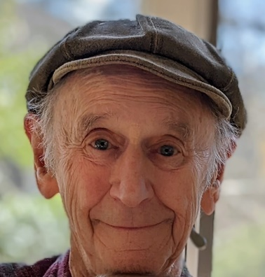
https://hhrecny.org/
Manfred Lindenbaum
Holocaust Survivor
Manfred “Manny” Lindenbaum is a Holocaust Survivor. At the age of 7 he and his older brother Sig, then 9, were shepherded by Polish troops to board the Kindertransport to England a day before World War II began. There, they were joined by thousands of other children who never saw their parents again.
A peace activist who has worked with refugees for many years, Manny has spoken to thousands of children about their responsibility to change the world by speaking out about hatred and bigotry. In 2014, Manny completed a 28-day odyssey, returning to his hometown in Poland accompanied by his wife, children, grandchildren and friends to retrace his steps and those of his family during the Holocaust.
Today, he speaks at community events and schools about bullying and diversity, referring to his Shoah background.
[location]
[date]
[time]
Event held at:

