Slide 1
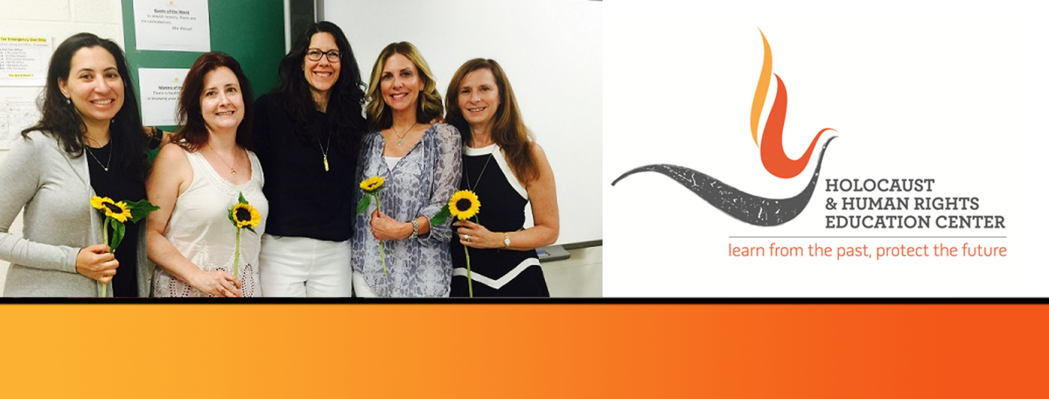

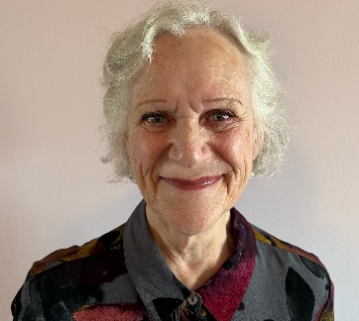
https://hhrecny.org/
Marion Novack,
GenerationsForward
Marion is the daughter and sister of Holocaust survivors. Her parents fled their
native Berlin in 1938, one month after Kristallnacht. They were members of
Hechalutz, a Zionist socialist youth movement, whose long-term goal was the
creation of a Jewish state in Palestine. Hechalutz worked with the Danish Agricultural Travel Bureau providing trainees, including my parents, to work on farms in Denmark in order to acquire the farming skills necessary to emigrate to Palestine.
Marion's parents lived and worked in Denmark on eight different farms until they were captured in October 1943 and deported to Theresienstadt concentration camp in Czechoslovakia. At the time, Marion's mother was seven months pregnant. They returned to Denmark after their liberation in April, 1944. More than sixty years later, Marion's parents documented their memories of their capture and internment in vivid, heartfelt letters they wrote to her.
Years after her parents died, Marion began a research effort to identify the Danish farmers who stored and protected her parents' belongings during their internment. Her research led to a fascinating and unique set of connections and discoveries resulting in a life changing visit to Denmark in 2010.
Marion has presented her family’s story to a wide variety of audiences. “I am the keeper of my parents’ story and their voices.”
[location]
[date]
[time]
Event held at:

