Slide 1


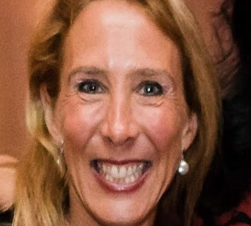
https://hhrecny.org/
Leah Sills,
GenerationsForward
Leah Rozenfeld Sills learned as an adult that her father, Stephen
Rozenfeld, as well as her grandparents, Abraham and Eugenia
Rozenfeld, escaped Poland and survived the Holocaust due to the immediate actions of Abraham who obtained transit visas from Bolivian Consul General Bilbao and subsequently through the heroic action of Aristides de Sousa Mendes, a Portuguese Diplomat stationed in Bordeaux, France. Sousa Mendes defied orders from his government and issued thousands of visas to people fleeing the Holocaust. Those people sought safety in Portugal and subsequently settled in countries around the world.
Sills presents her family’s story of escape, both in the US and in Portugal. She has been interviewed by national and international reporters about this topic
[location]
[date]
[time]
Event held at:

