Slide 1
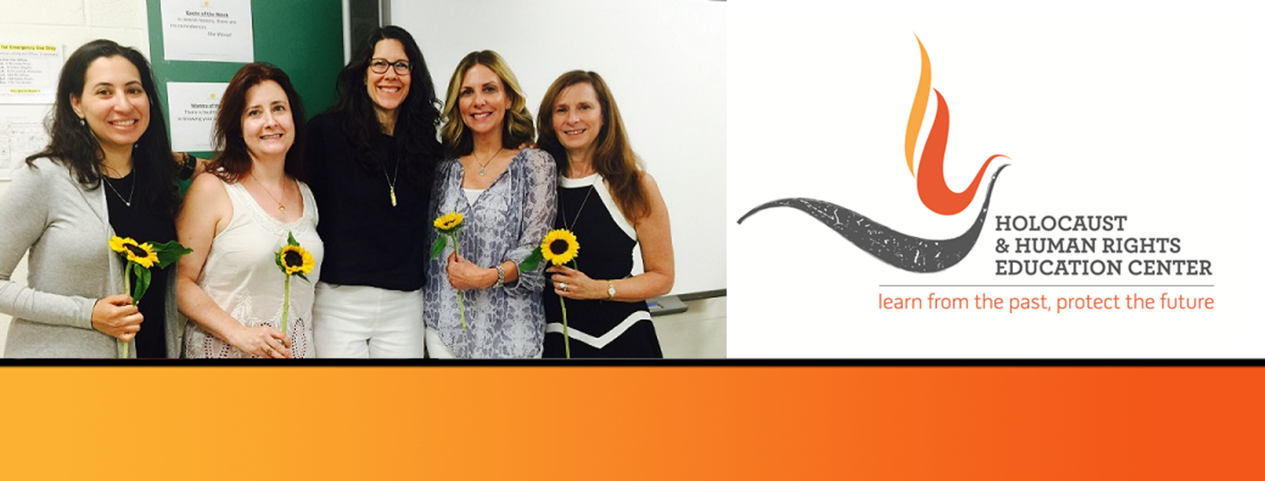

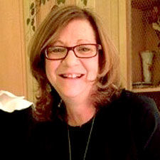
https://hhrecny.org/
Kathy Grosz-Zaltas,
GenerationsForward
Kathy is a daughter of Holocaust survivors, and she tells their story to
honor their lives and have it serve as a powerful lesson to confront bullying, injustice, antisemitism and bigotry in our world today. Her parents grew up in different parts of Czechoslovakia, enjoying a happy, cultured, well-to-do life. And then, suddenly, the Nazi era began to control them, in an attempt to destroy their families forever. Despite their hardships living in concentration camps, enduring forced labor and death marches, survival was their personal miracle.
Kathy speaks about their lives after the War, and of their growing family in America. She discusses what it is like to be part of the Second Generation. She was a foreign language teacher for 17 years in Westchester County. Kathy and her family are the owners of Zaltas Fine Jewelers. Kathy curates fine jewelry and creates custom designed pieces for her clients. She created the Hope Sunflower Collection, inspired by her family history to honor her parents and HHREC. A portion of sales from the Collection are donated to HHREC. Kathy is co-host of the HHREC MemoryKeeper Story Hour, a series of events offered on Zoom featuring HHREC GenerationsForward Speakers.
[location]
[date]
[time]
Event held at:

