Slide 1
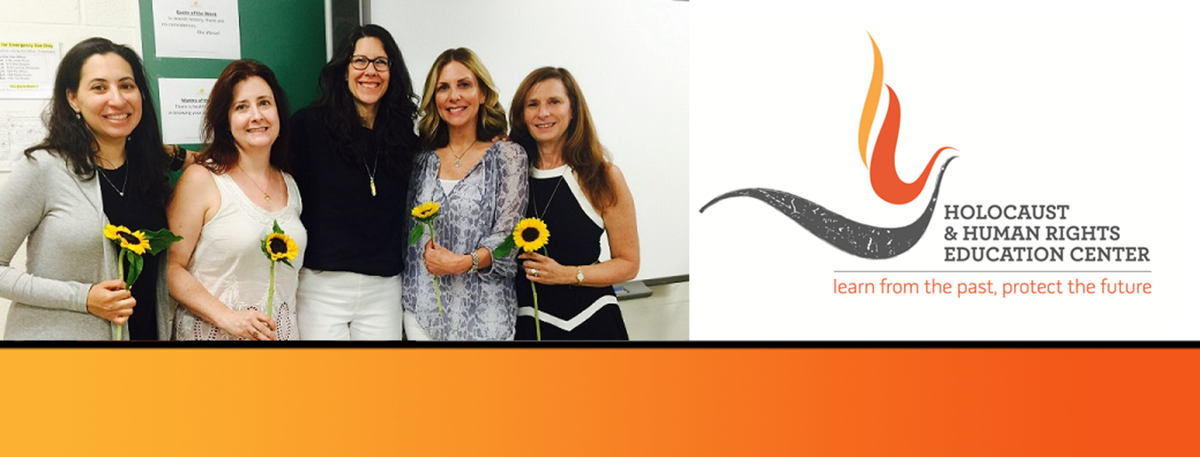

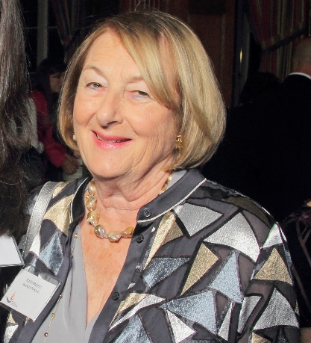
https://hhrecny.org/
Karin Meyers,
GenerationsForward
Karin Beuthner Meyers was born in Wuppertal, Germany on
June 7, 1937. Her father, an obstetrician, delivered her at home as Jews
were no longer admitted to hospitals and Jewish doctors were not
allowed to treat Non-Jews. However, Dr. Beuthner continued the care for
his patient and for this he was arrested. Later freed, Karin tells the story of
her parents’ emigration ordeal as well as the fates of other members of
her family that are pictured in a faded photograph taken the last time they
were together in the Spring of 1938. The photograph becomes a focal point of the story that Karin weaves in verse and narrative form. Her story illustrates the importance of perseverance, luck and particularly, how the good deeds of some affected her family’s outcome.
Karin Beuthner Meyers graduated with honors from Brandeis University and received a Masters of Humanities degree. She was an adjunct lecturer in Medical Ethics at Mt. Sinai Hospital in New York City and a member of its Institutional Research Review Board. Karin authored several articles on the ethics of Human Research Ethics.
Karin is a member of GenerationsForward, a group of second and third generation individuals sponsored by the Holocaust and Human Rights Education Center of White Plains, New York.
[location]
[date]
[time]
Event held at:

