Slide 1



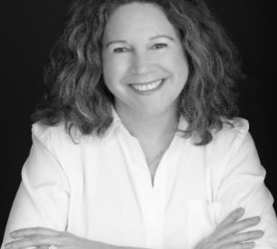
https://hhrecny.org/
June Hersh,
GenerationsForward Speaker
June Hersh is the best-selling author of Food, Hope & Resilience;
Authentic Recipes and Remarkable Stories from Holocaust Survivors,
a book was first released in 2011 under the title Recipes Remembered, and
has sold over 20,000 copies, with all proceeds going to charity. In connection with the book, June has spoken to hundreds of groups across the country, has made several television appearances, including on QVC where she was a featured guest. Her talks focus on the wonderful anecdotes and life affirming stories related to her interactions with over 100 Holocaust survivors. The talk is an unexpected blend of humor and inspiration as she shows the wonderful connection and deep respect she has for this remarkable community. She has also penned the widely acclaimed Iconic New York Jewish Food, a History and Guide with Recipes, which can be incorporated into her talk. Her other works include, The Kosher Carnivore, Still Here, Inspiration from Survivors and Liberators of the Holocaust, Yoghurt a Global History and The Flavor of Upstate New York. She is currently at work on a book with James Beard award-winning chef Alon Shaya, as they explore stories from WWII through the lens of food. June is a regular contributor to Westchester Magazine and various food publications and is a member of the prestigious culinary organization Les Dames d' Escoffier. Her goal is to honor the legacy of Holocaust survivors, preserve Jewish food memory and Eat Well-Do Good through the charitable flavor of her books.
Event held at:
[location]
[date]
[time]

