Slide 1
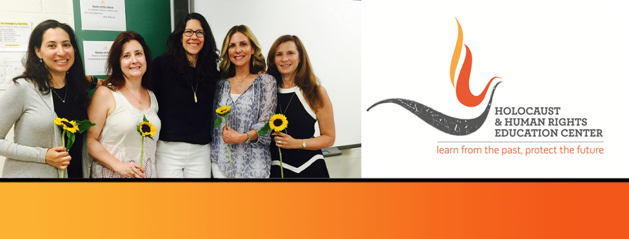

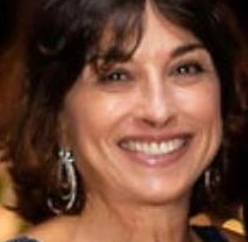
https://hhrecny.org/
Julie Sherman,
GenerationsForward Speaker
Julie Sherman is the daughter of a Holocaust survivor, Helen Sherman, born
Chaya Scharfer. Julie tells the story of her mother, one of eight children born
to an orthodox Hasidic German family. The family lived in Danzig, which is now
Gdańsk Poland, and owned the largest kosher hotel on the Baltic Sea.
Julie’s mother, who was nine years old, and her sister, who was seven years old,
were sent on a Kindertransport to England. In England they lived with relatives
who mistreated them and were later moved to a hostel.
After the war, all eight siblings and both parents were reunited in Brooklyn, NY. There were many “upstanders”, ordinary people, Jews, non-Jews, and even Nazis who helped her mother’s family survive. Theirs is a story of miracles, but also of great loss and trauma. Julie tells the family story and talks about the lingering effects of their experiences and what it was like to grow up as a child of a survivor. She is a member of Generations Forward, a group of second and third generation individuals sponsored by the Holocaust & Human Rights Education Center in White Plains, NY.
Event held at:
[location]
[date]
[time]

