Slide 1


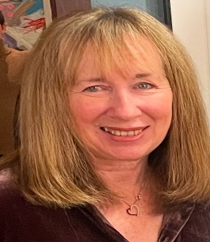
https://hhrecny.org/
Jeanette Cohen
GenerationsForward Speaker
Jeanette Silverstein Cohen is the daughter of Holocaust survivors. Her mother, Renee was the sole survivor of her immediate family.
Upon her death in 2022 at the age of 98 Jeanette found letters hidden in leather wallets that were sent to Renee while she was imprisoned in a labor camp. These letters written by her father document her parents' experience in the Bedzin Ghetto up until the time of final liquidation of the Ghetto in August of 1943. Jeanette's mother's story is one of loss and incredible resilience - resilience that was aided by the words written to her by her father.
[location]
[date]
[time]
Event held at:

