Slide 1
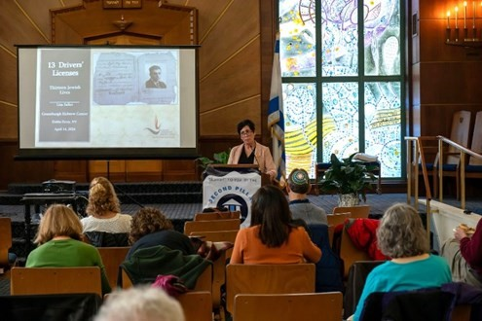


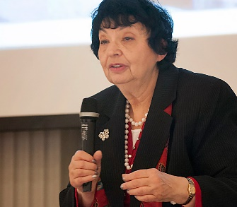
https://hhrecny.org/
Inge Auerbacher,
Holocaust Survivor Speaker
Inge Auerbacher was the last Jewish child born
in Kippenheim, a village in South-Western Germany located at the foot of the Black Forest, close to the borders of France and Switzerland. The only child of Berthold and Regina Auerbacher (nee’ Lauchheimer,) her parents came from observant Jewish families who lived for many generations in Germany. She has lectured on the Holocaust since 1981 and spoken to thousands of people in the U.S. Canada and Germany. She is fluent in German and English.
Inge is an author of best-selling books and has appeared on radio and television programs. Prize-winning documentary films have been made about her, and her most recent film: "The Olympic Doll" based on her book "I Am A Star" was made for middle school children as a lesson of tolerance.
Event held at:
[location]
[date]
[time]

